Slide 1

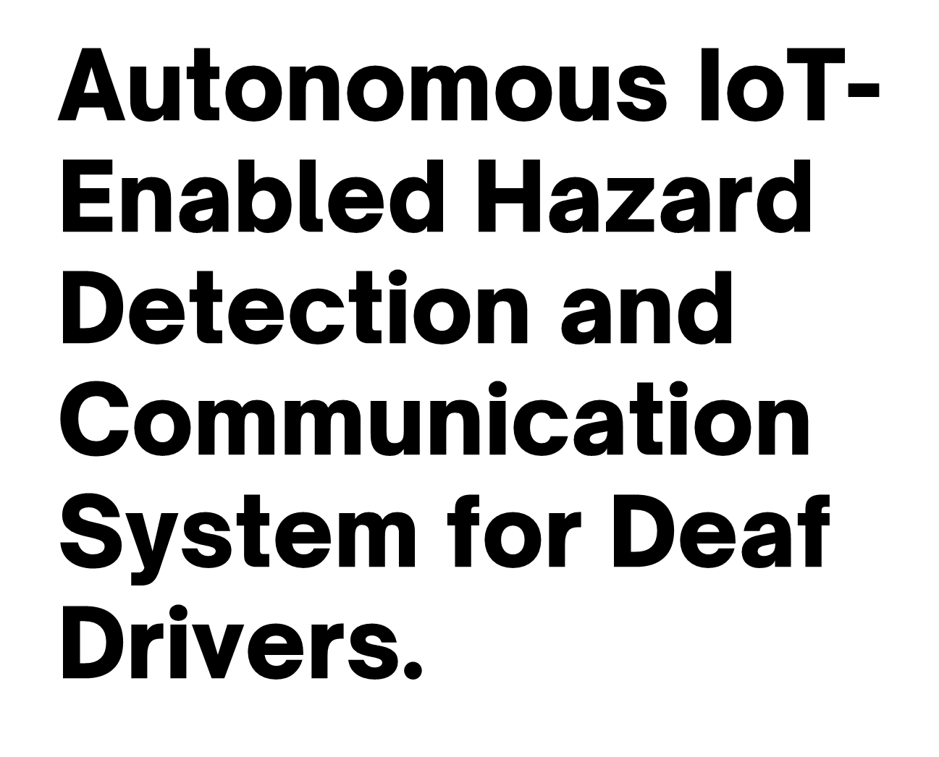


Slide 2

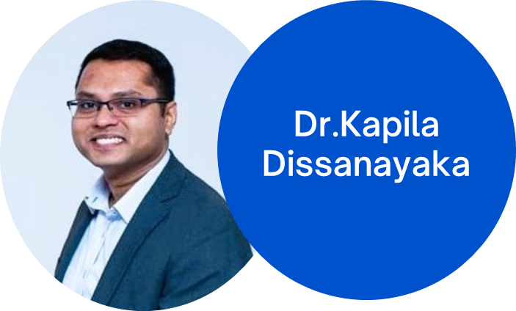
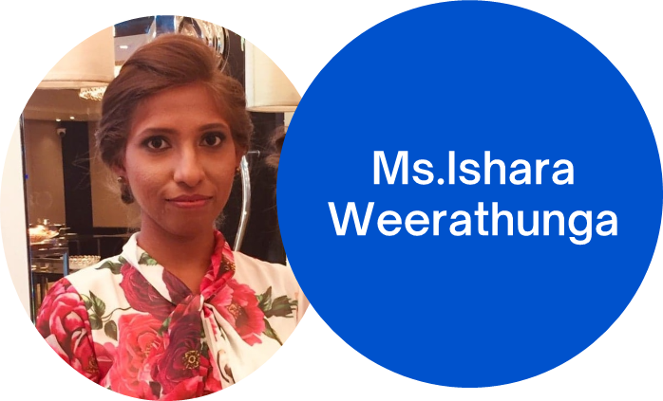
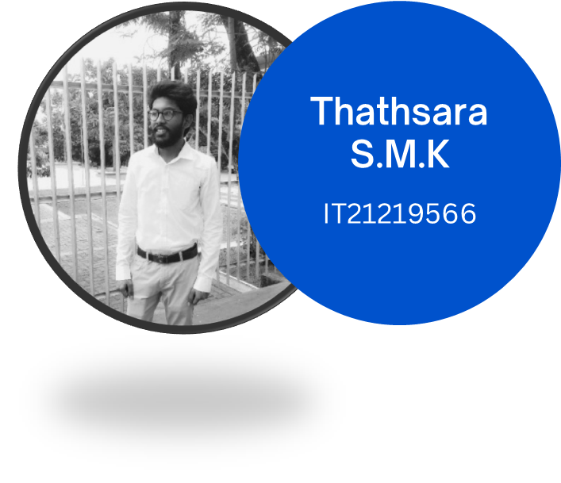
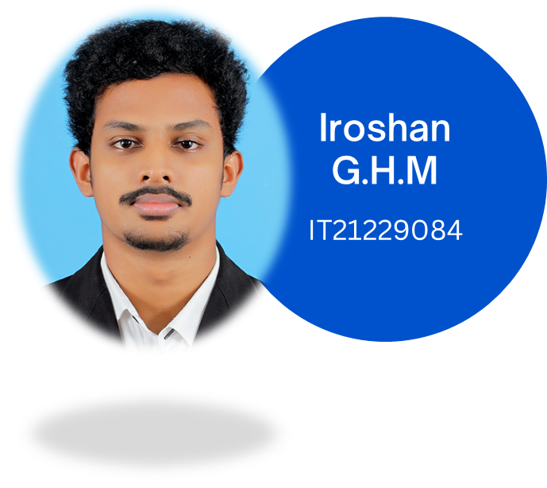
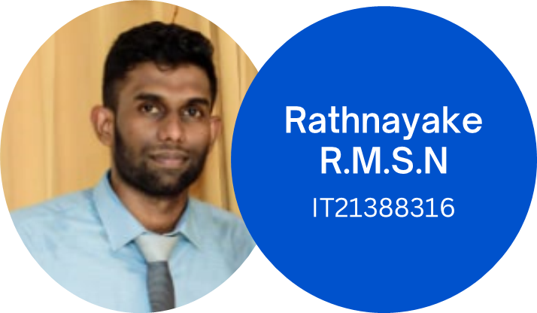
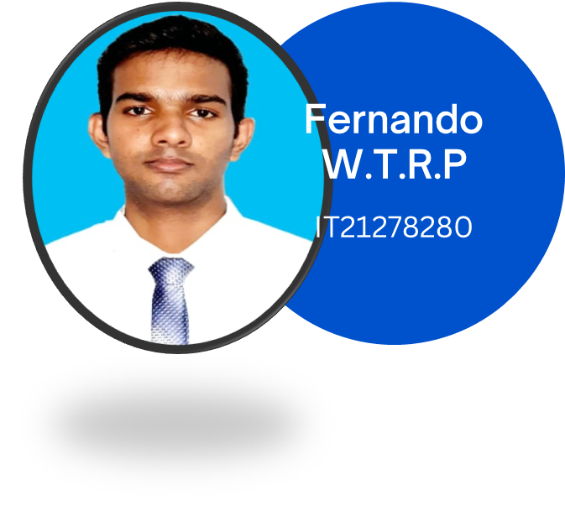

Slide 3


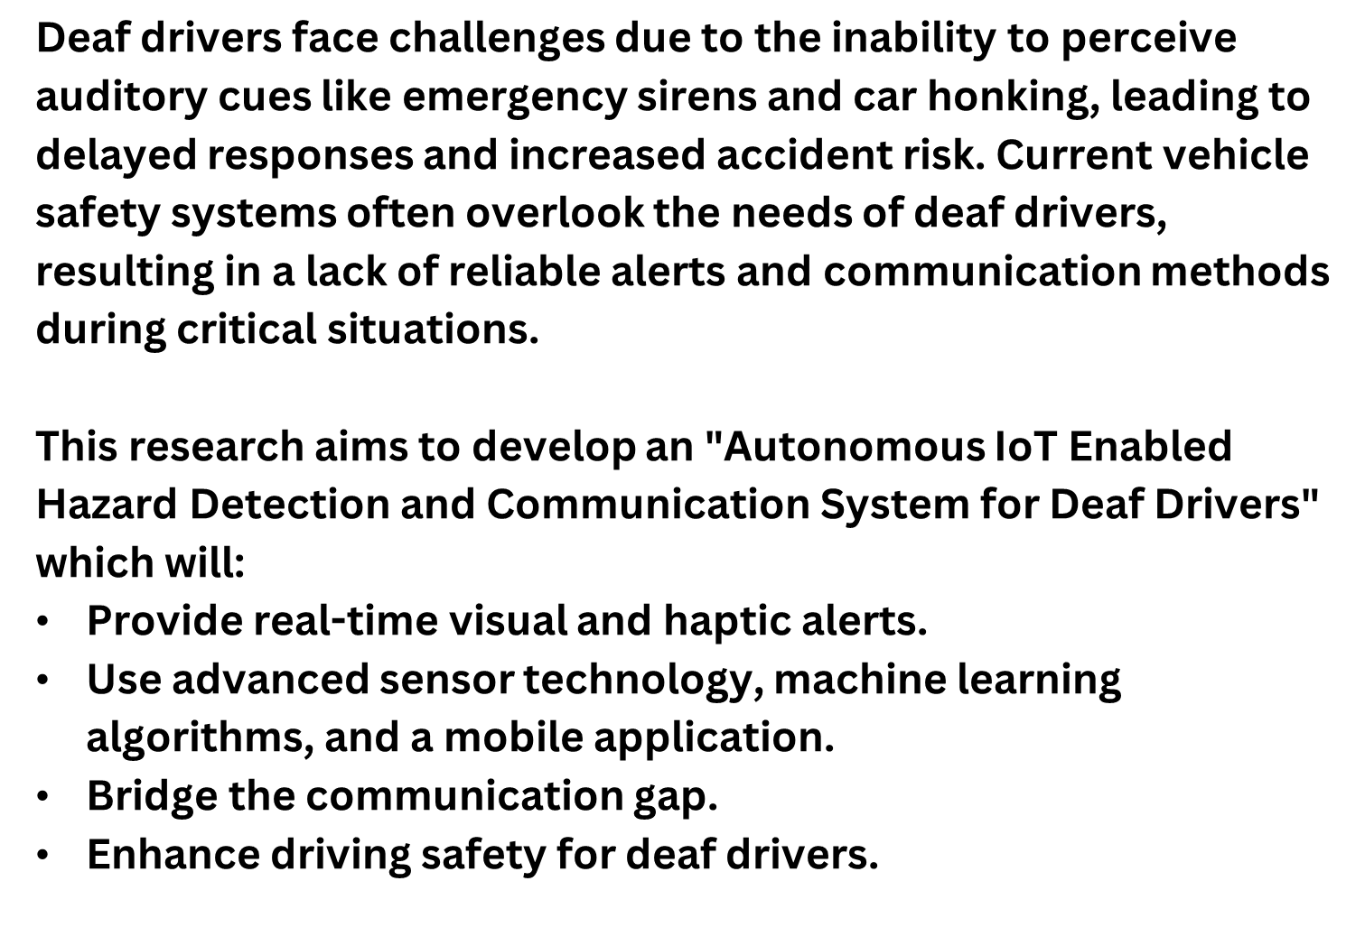

Slide 4


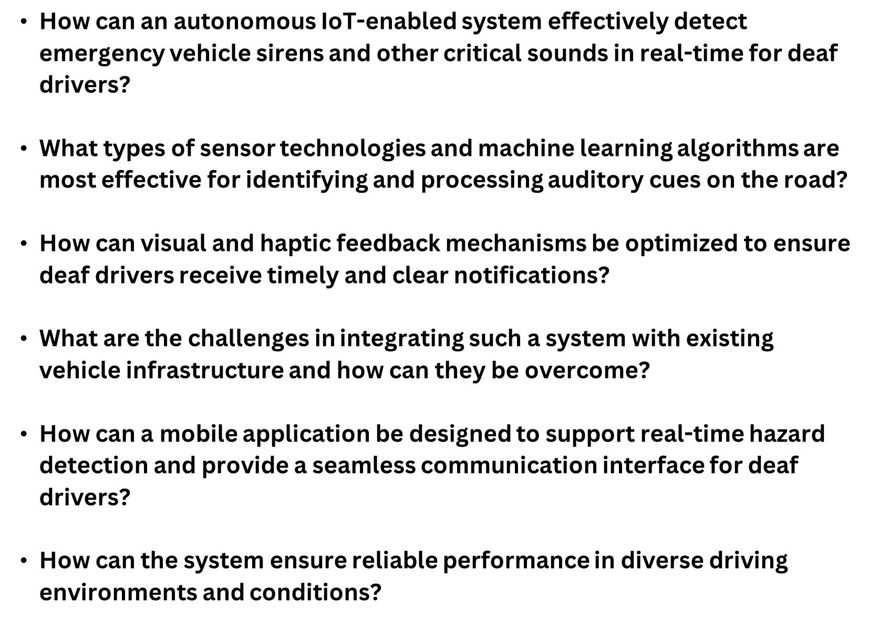

Slide 5







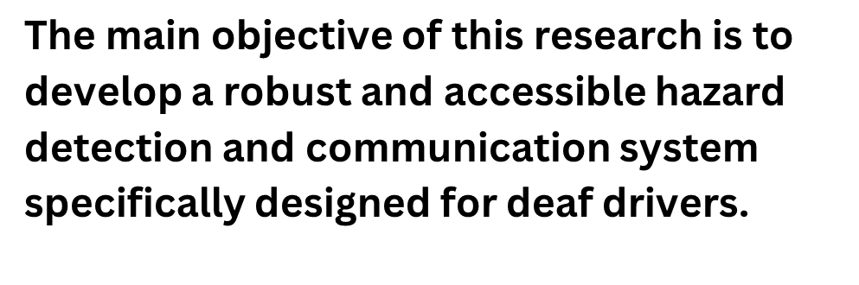
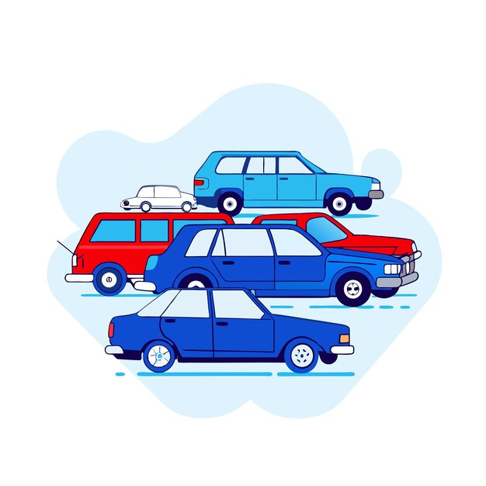

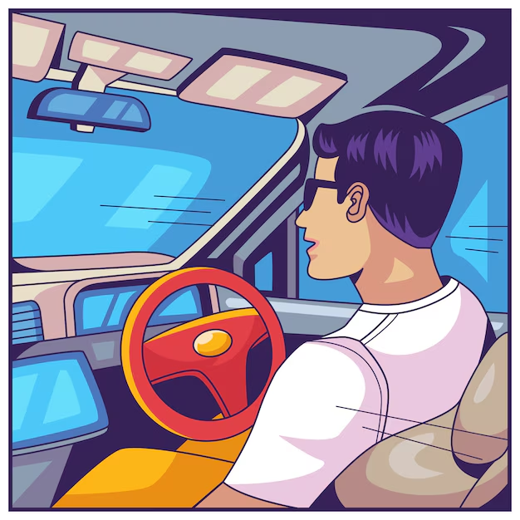

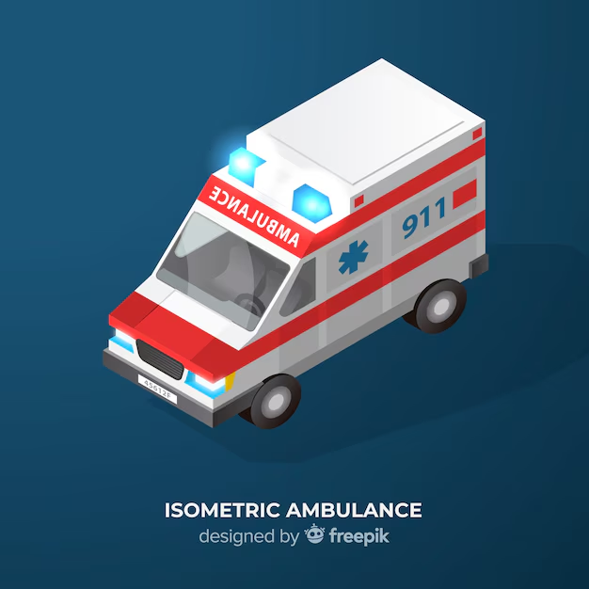


Slide 6
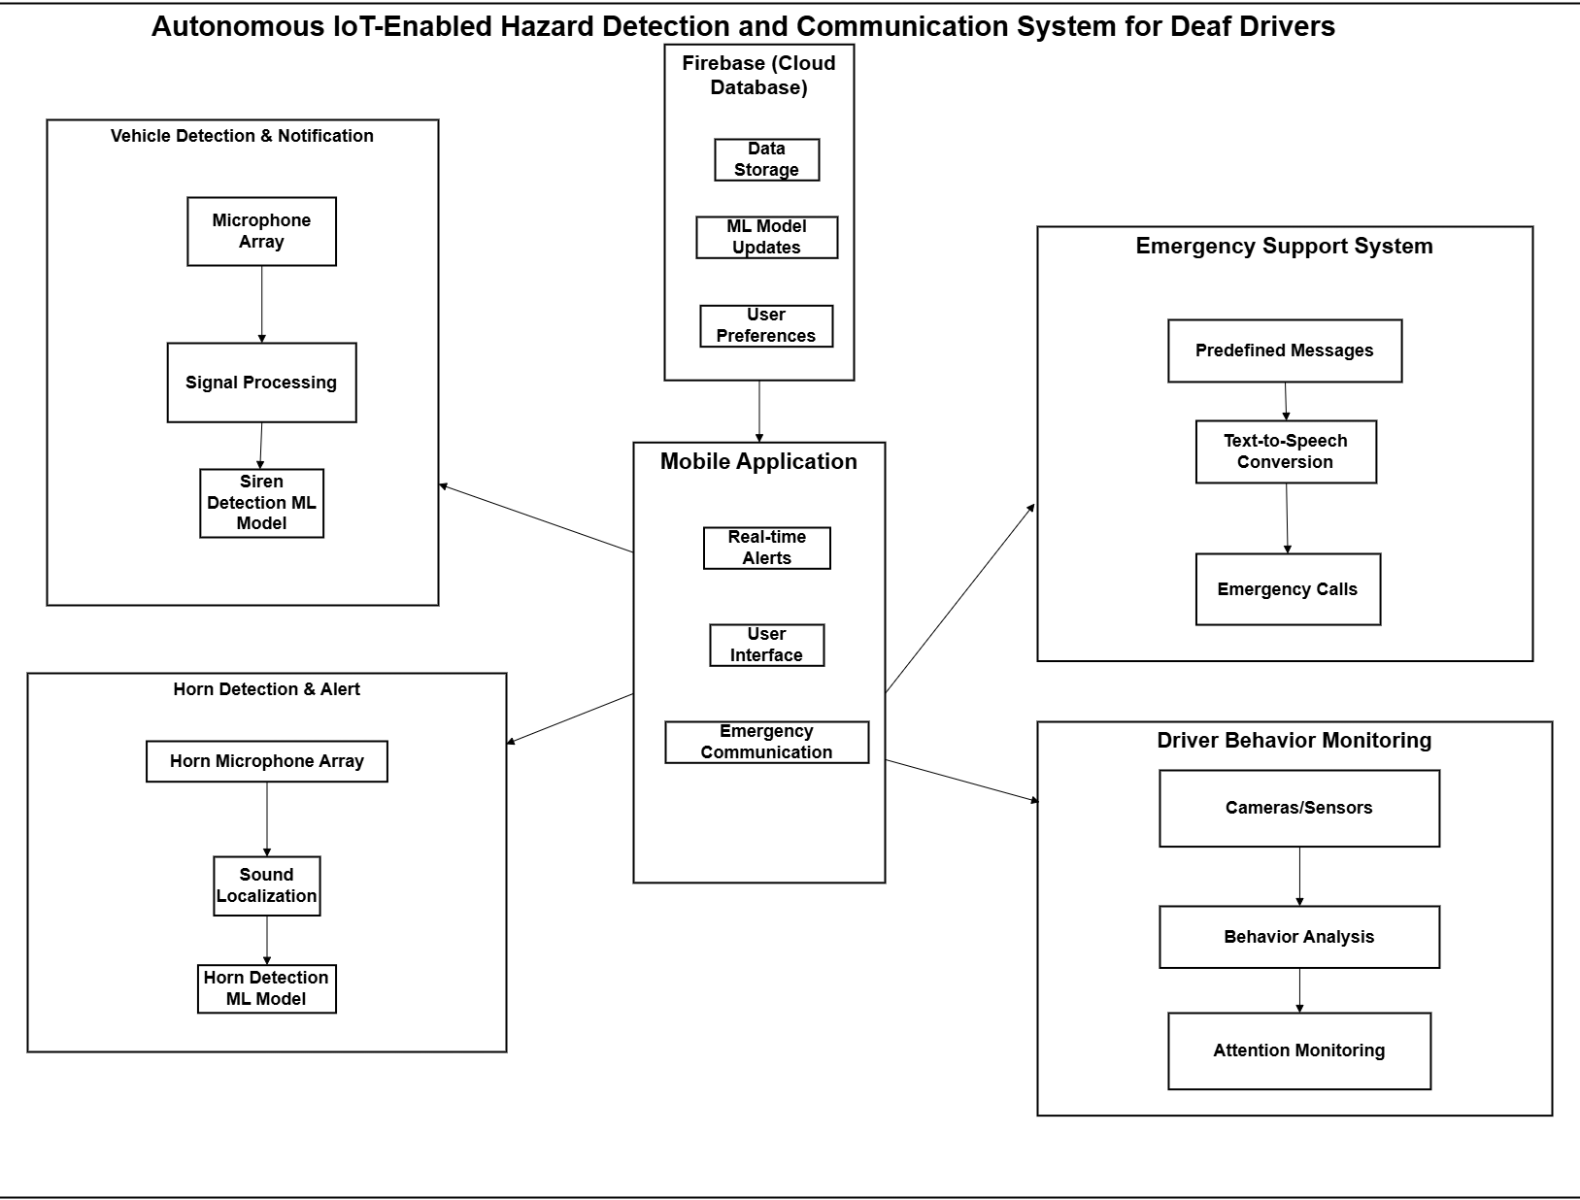
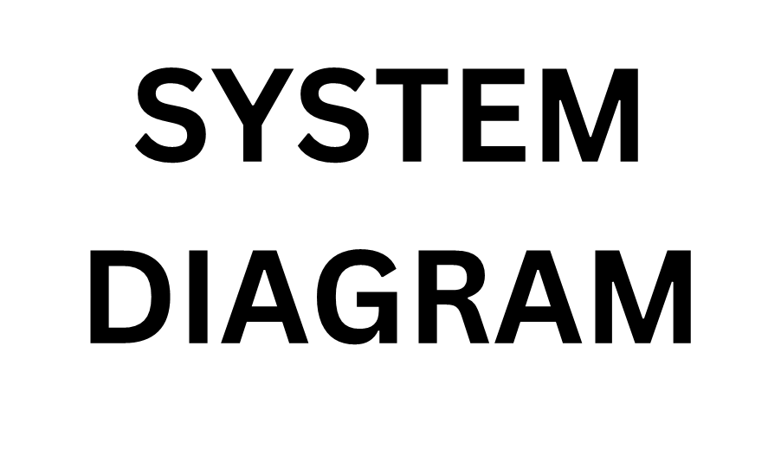

Slide 7


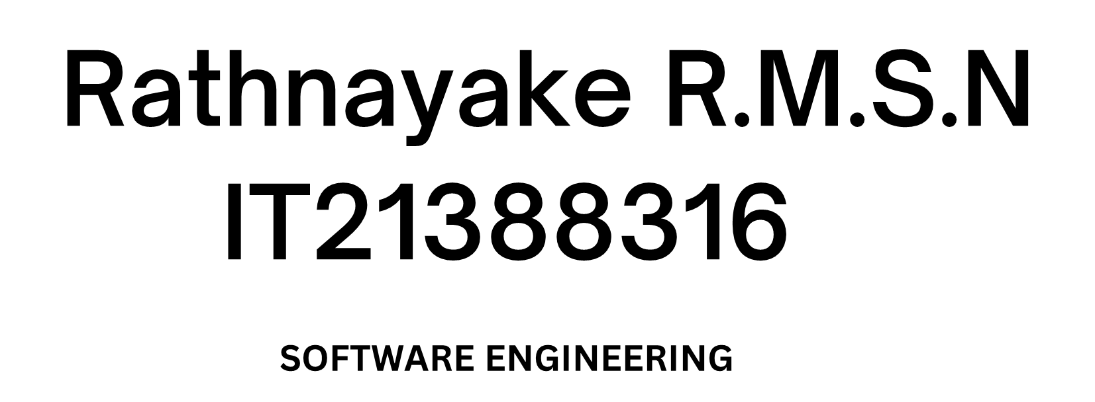
IT21388316 | Rathnayake R.M.S.N | 24-25J-132

Slide 8
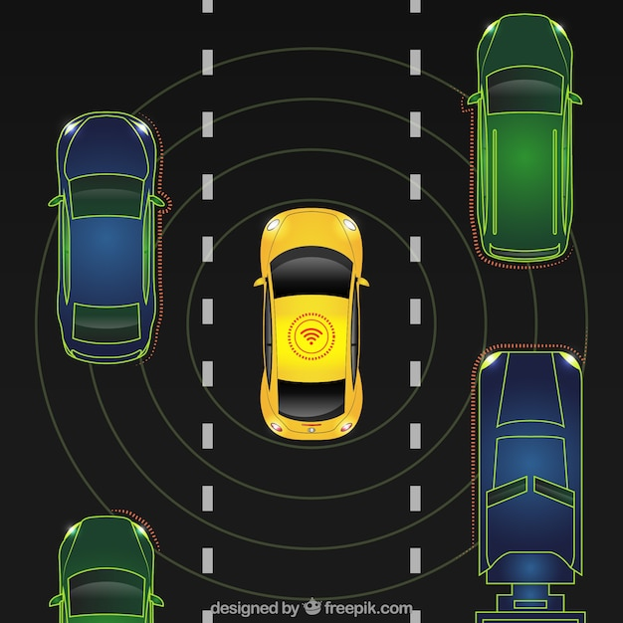
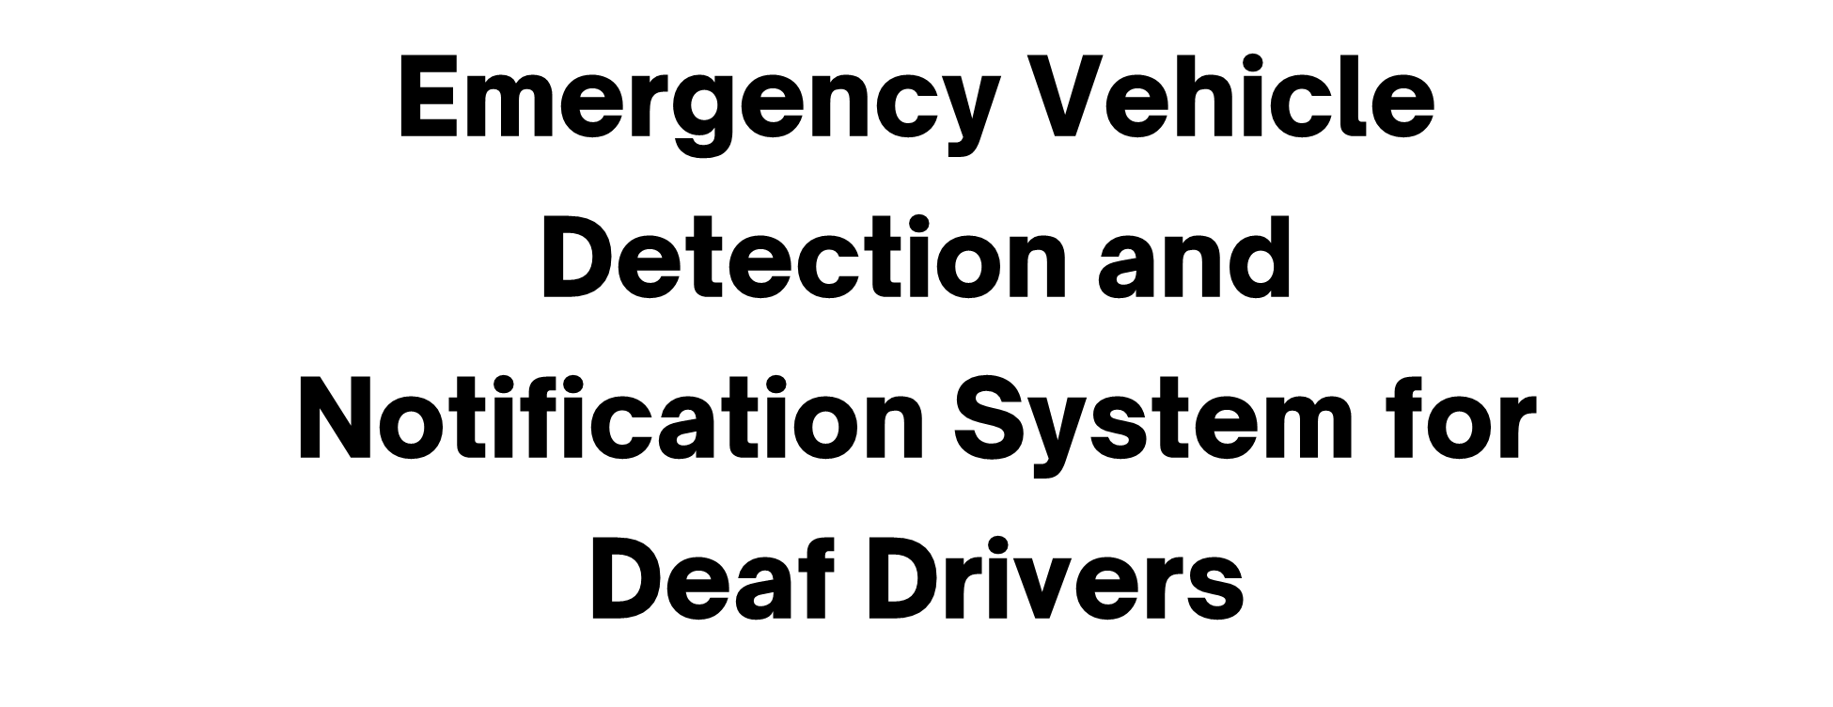
IT21388316 | Rathnayake R.M.S.N | 24-25J-132

Slide 9

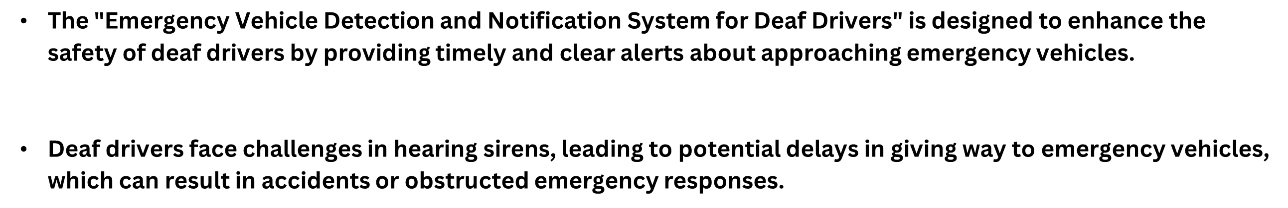
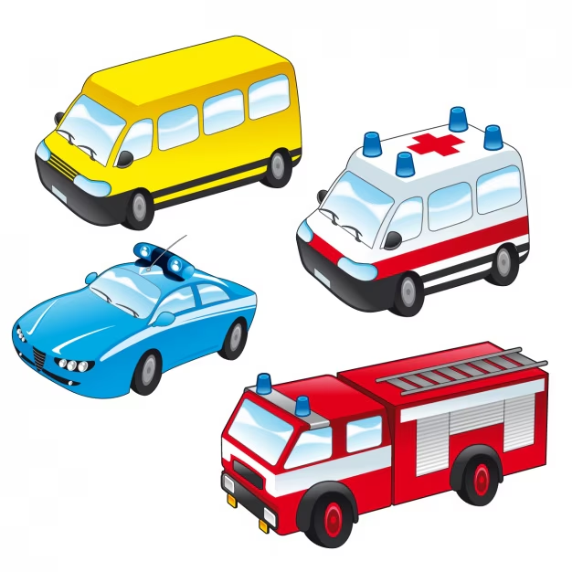
IT21388316 | Rathnayake R.M.S.N | 24-25J-132

Slide 10

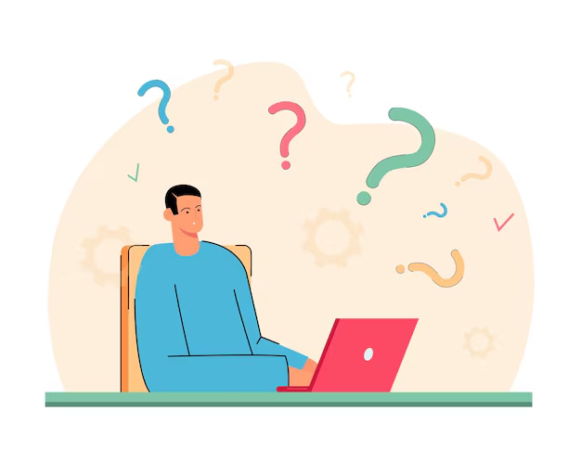
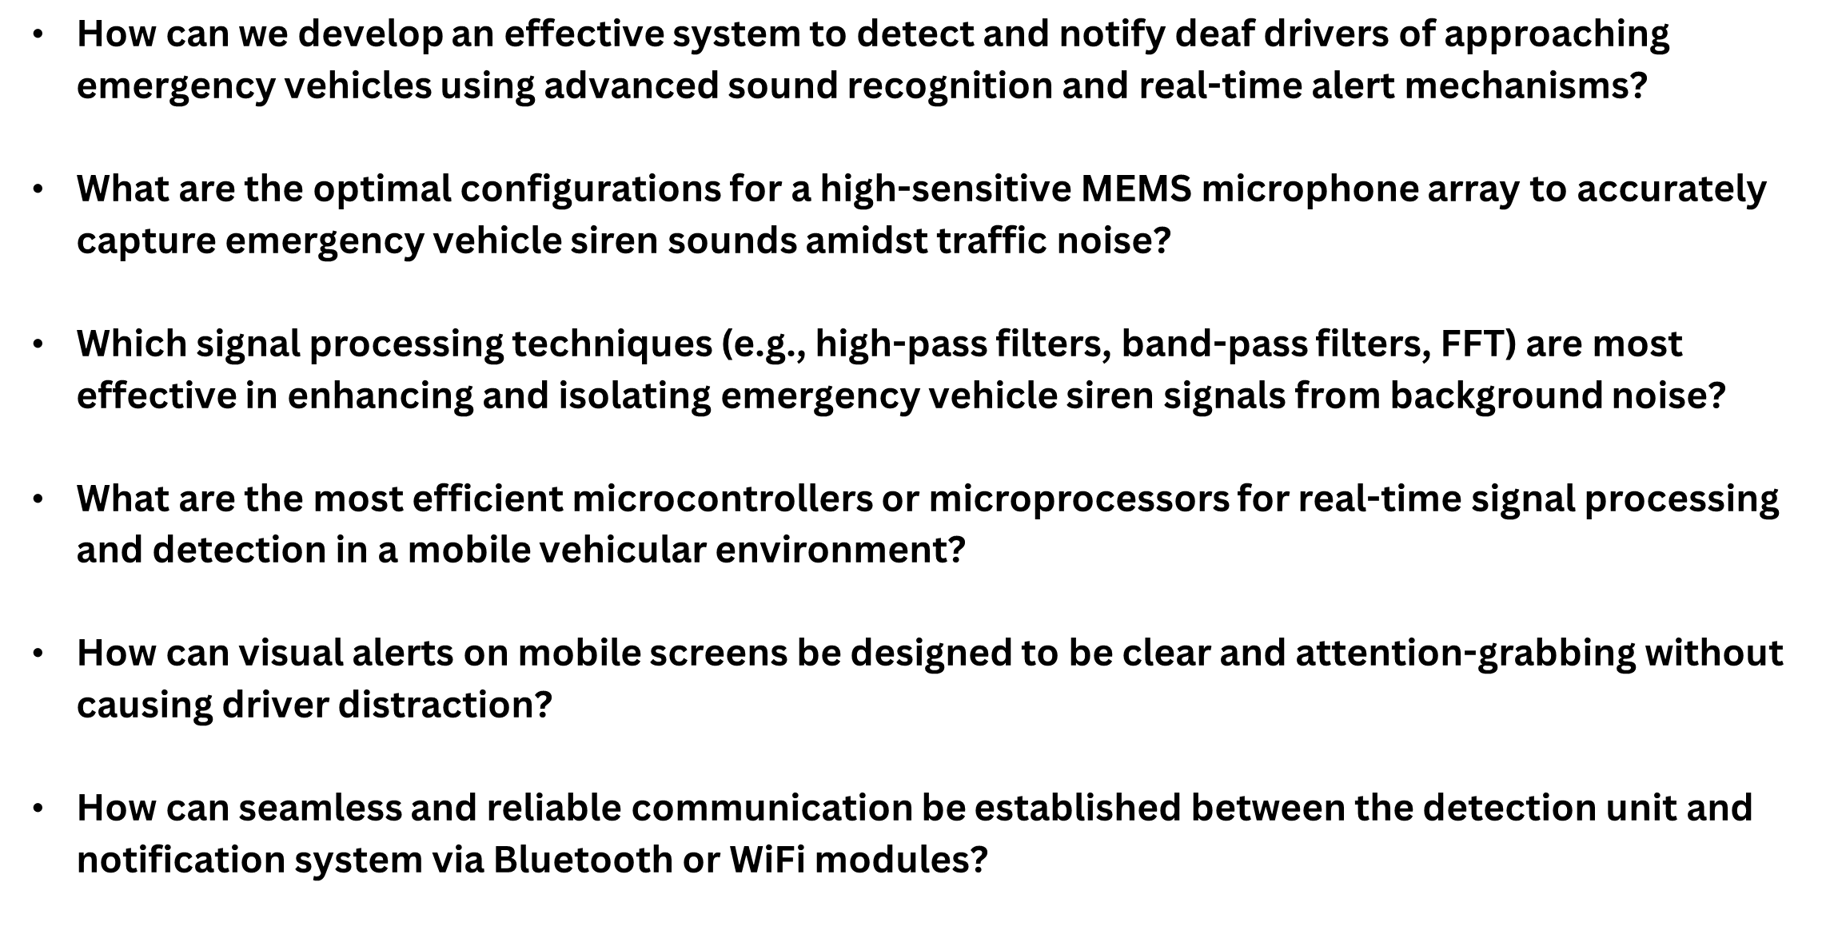
IT21388316 | Rathnayake R.M.S.N | 24-25J-132

Slide 11

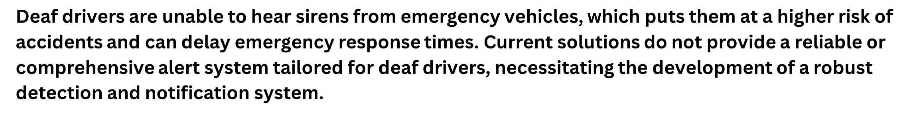
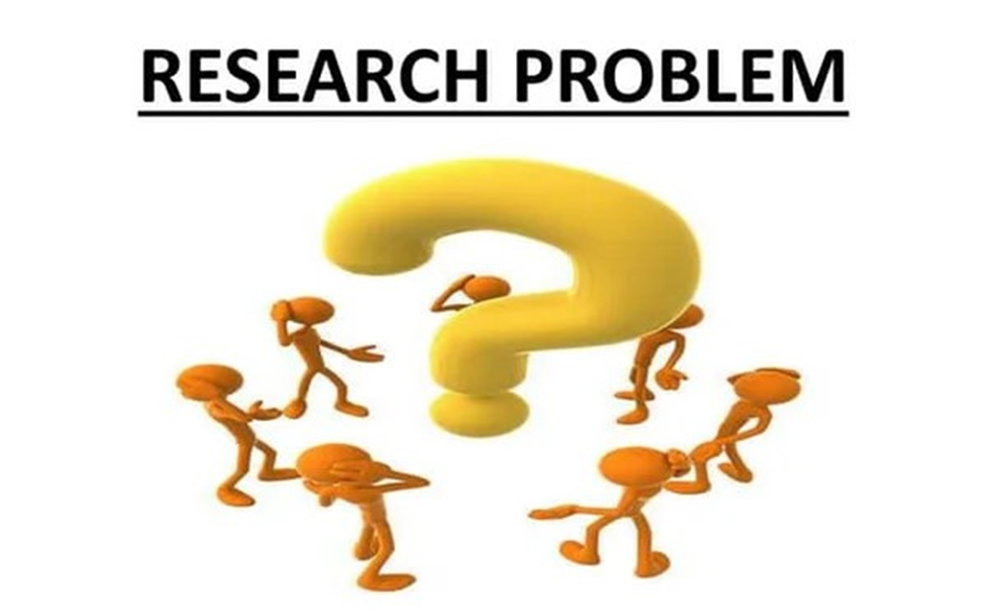
IT21388316 | Rathnayake R.M.S.N | 24-25J-132

Slide 12

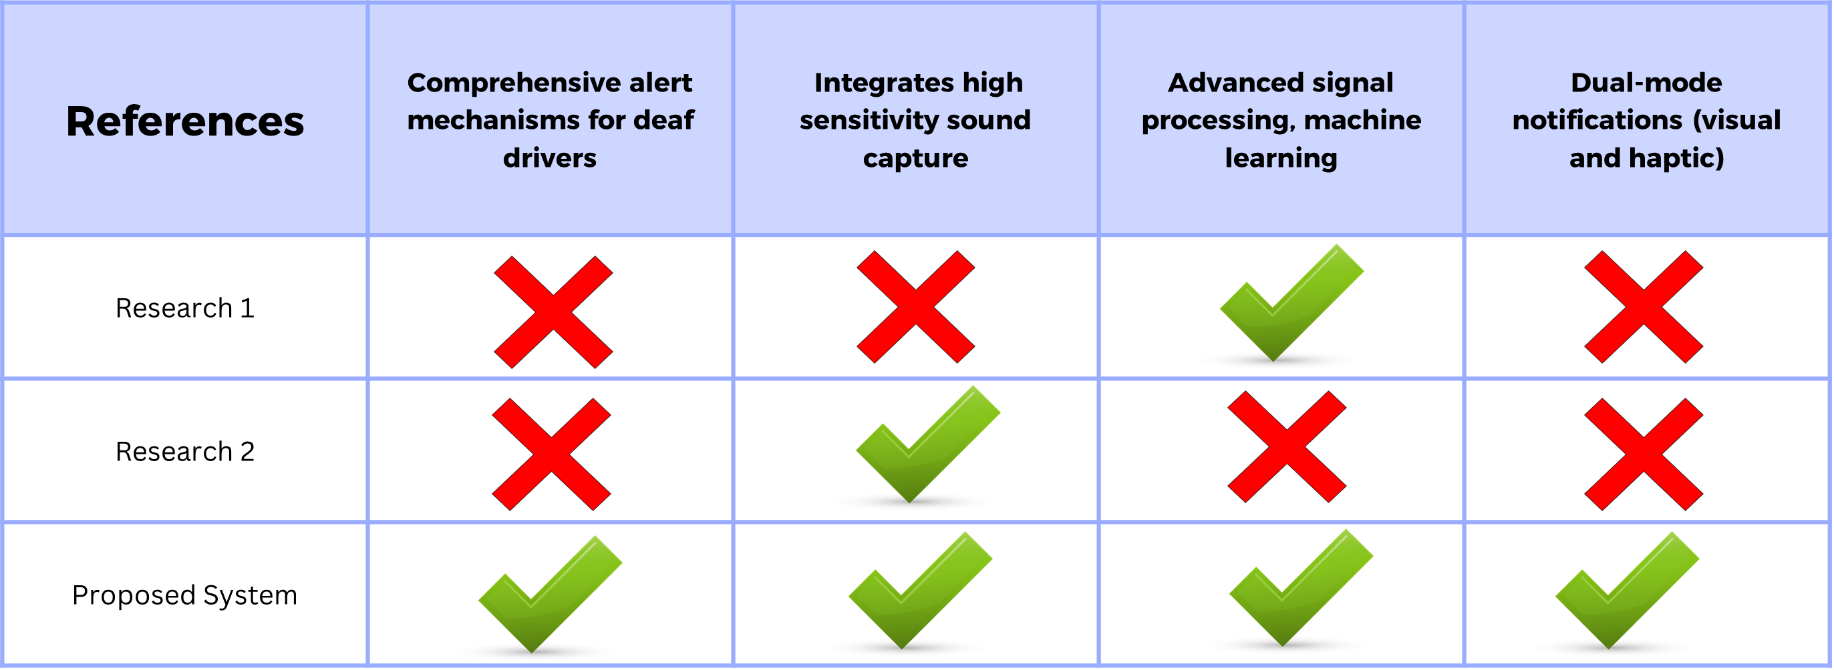
IT21388316 | Rathnayake R.M.S.N | 24-25J-132

Slide 13

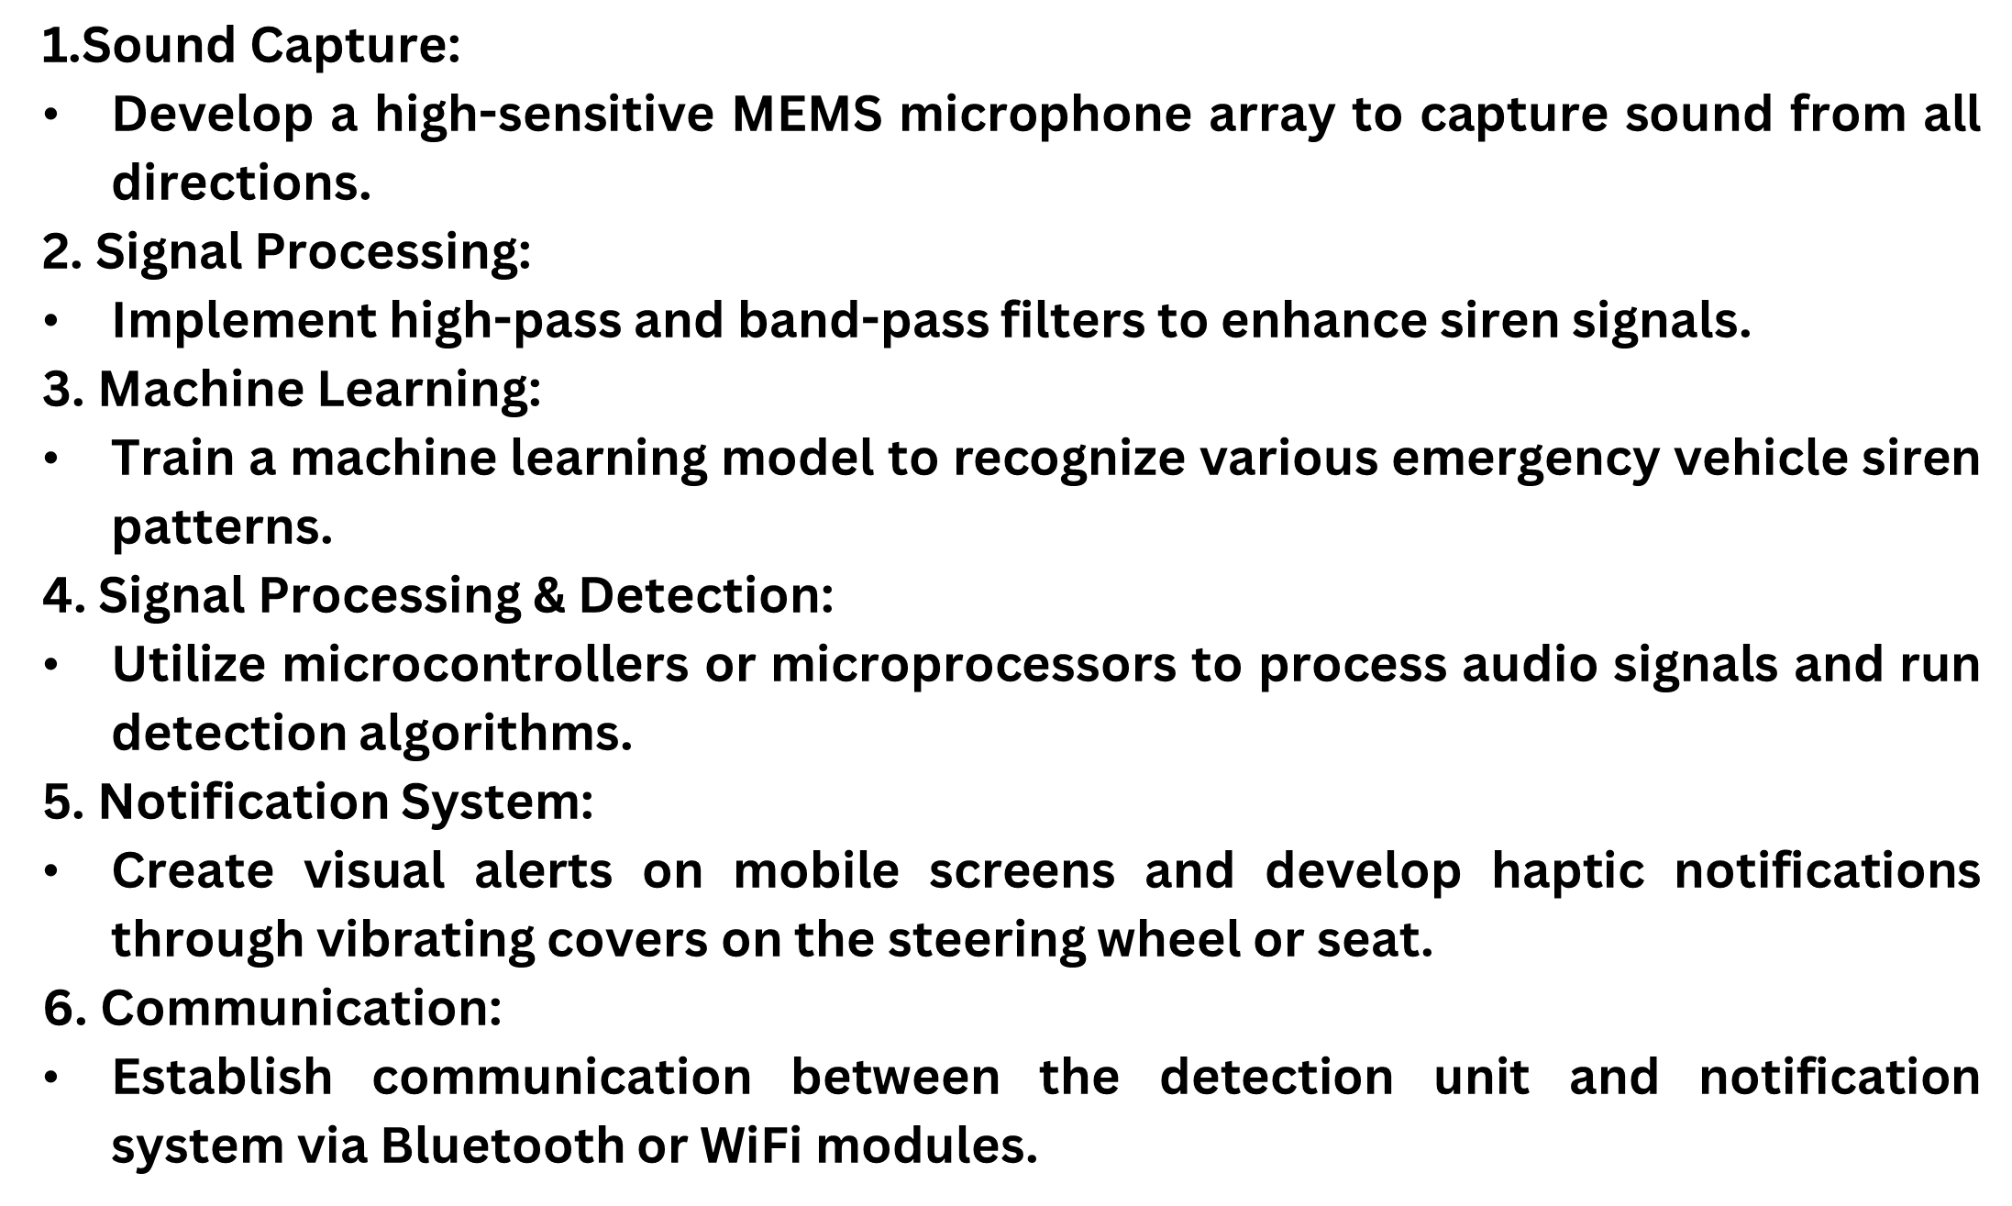

IT21388316 | Rathnayake R.M.S.N | 24-25J-132

Slide 14

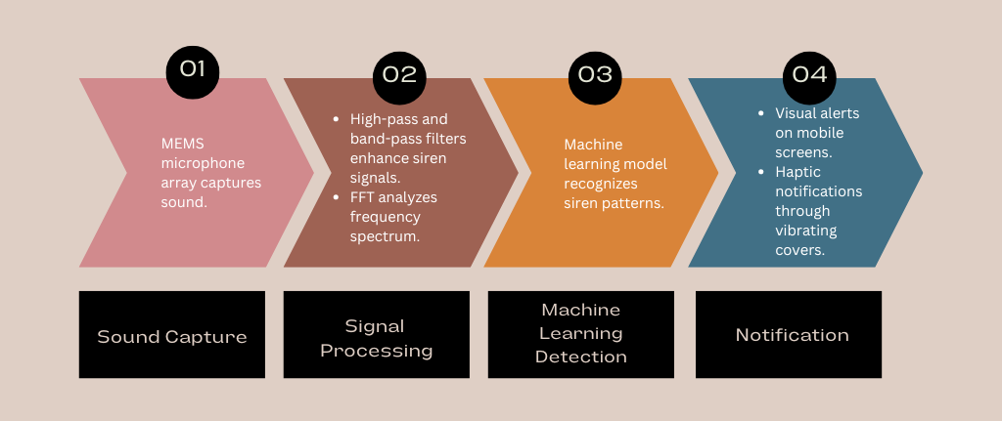
IT21388316 | Rathnayake R.M.S.N | 24-25J-132

Slide 15


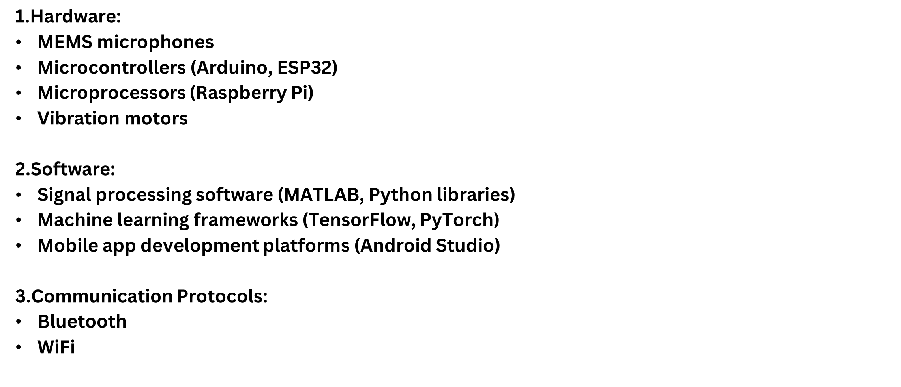
IT21388316 | Rathnayake R.M.S.N | 24-25J-132

Slide 16

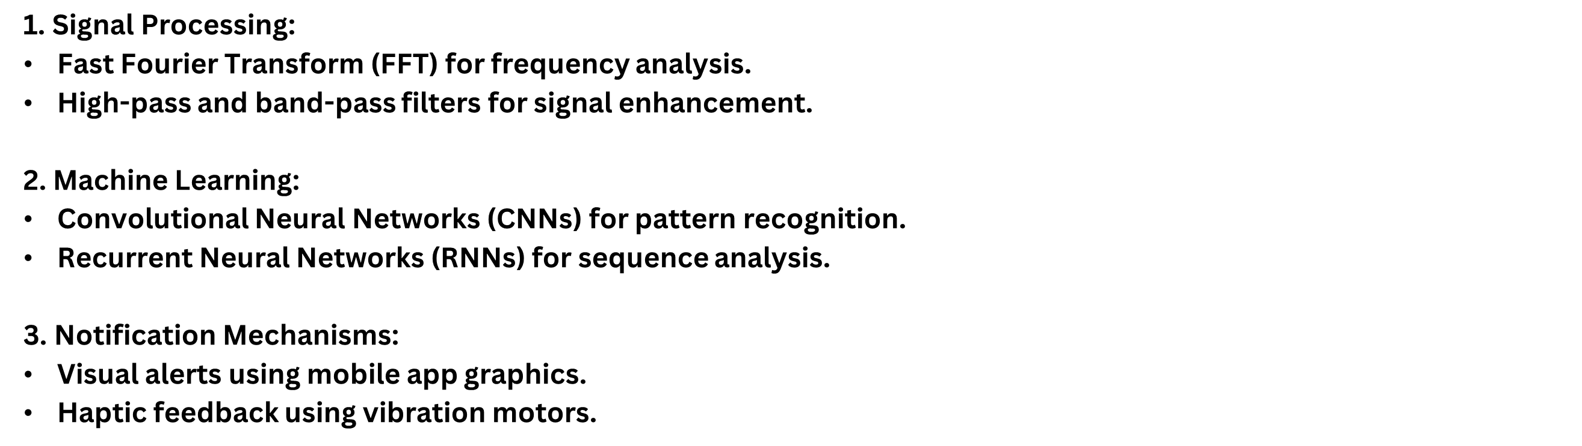

IT21388316 | Rathnayake R.M.S.N | 24-25J-132

Slide 17



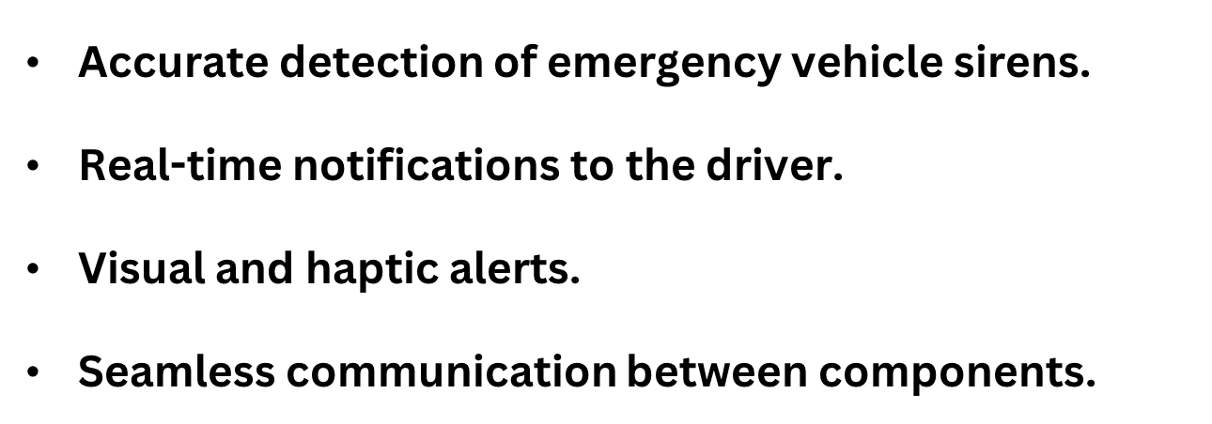
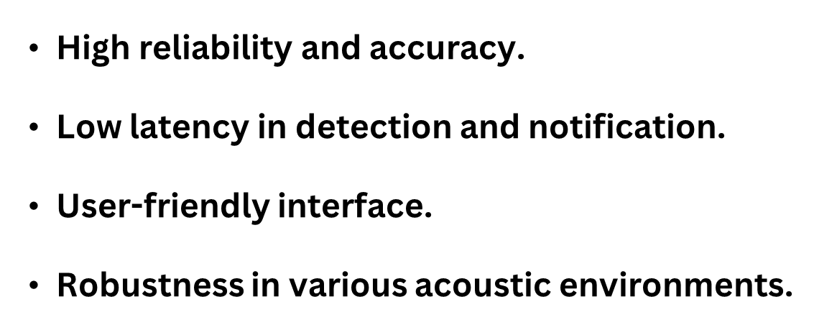

IT21388316 | Rathnayake R.M.S.N | 24-25J-132

Slide 18


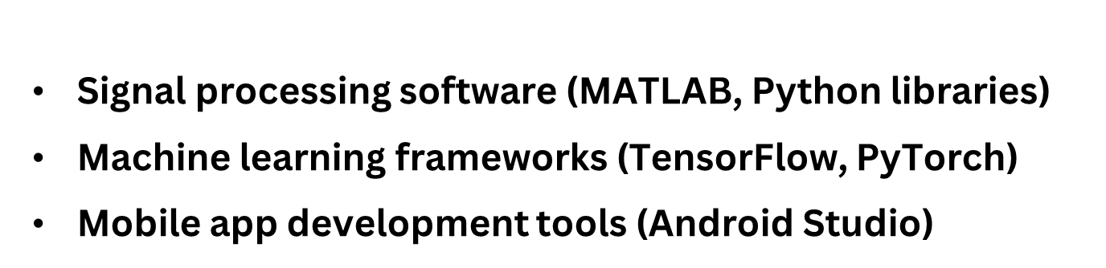


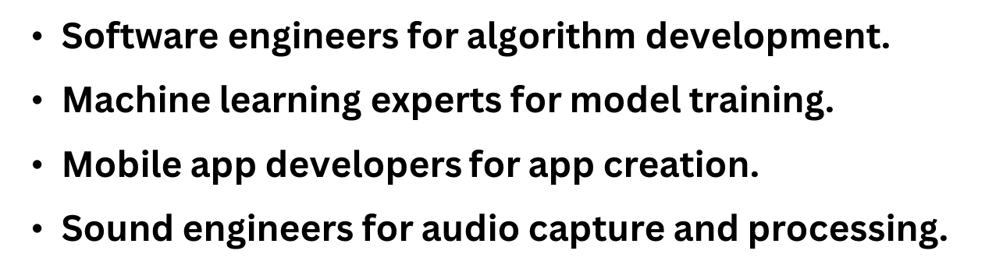
IT21388316 | Rathnayake R.M.S.N | 24-25J-132

Slide 19

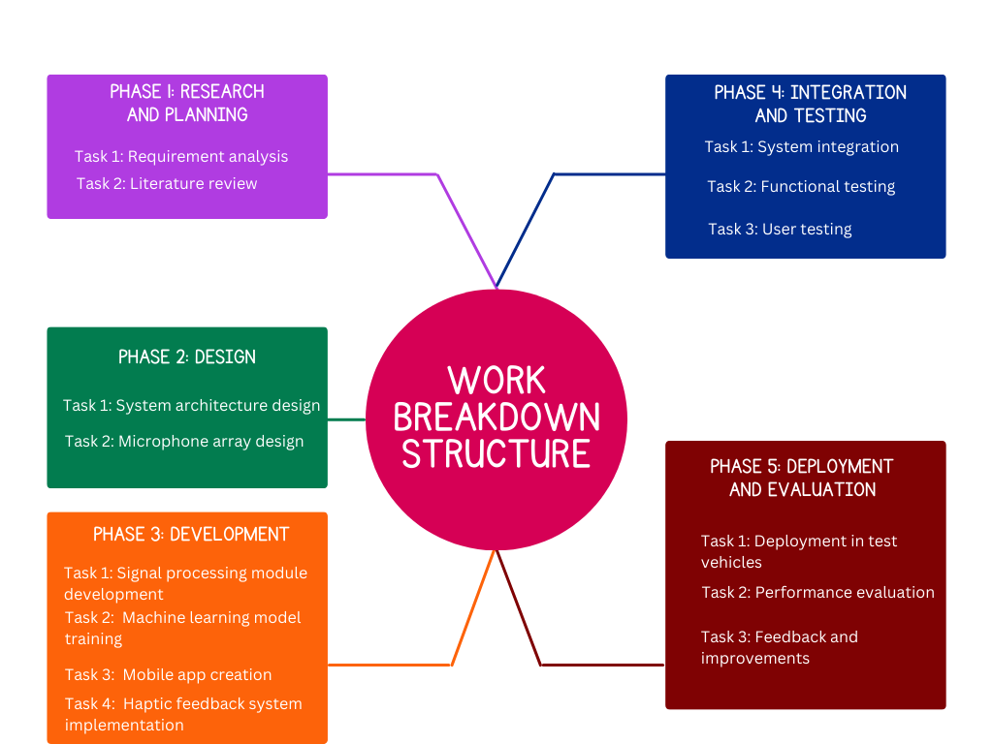
IT21388316 | Rathnayake R.M.S.N | 24-25J-132

Slide 20


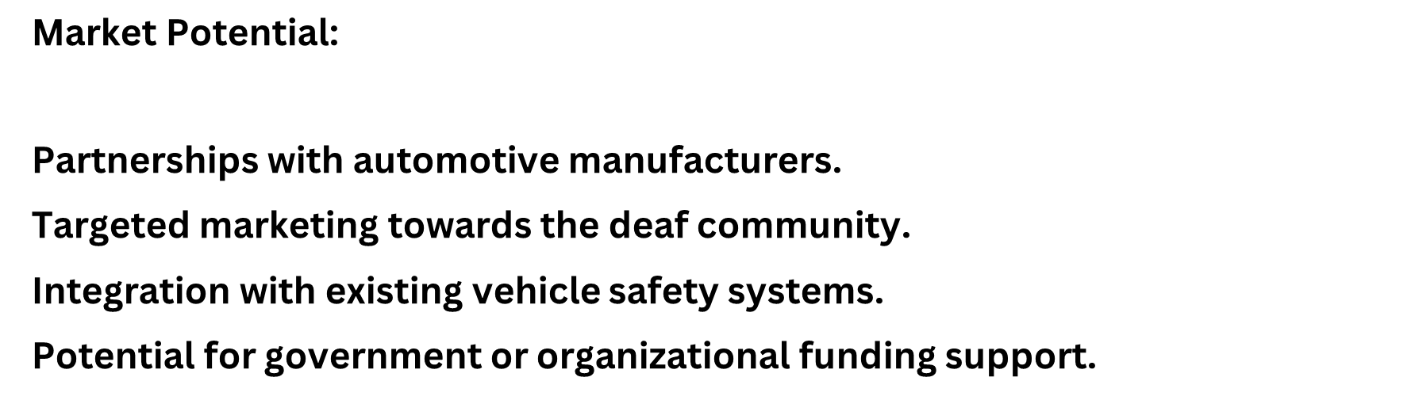
IT21388316 | Rathnayake R.M.S.N | 24-25J-132

Slide 21

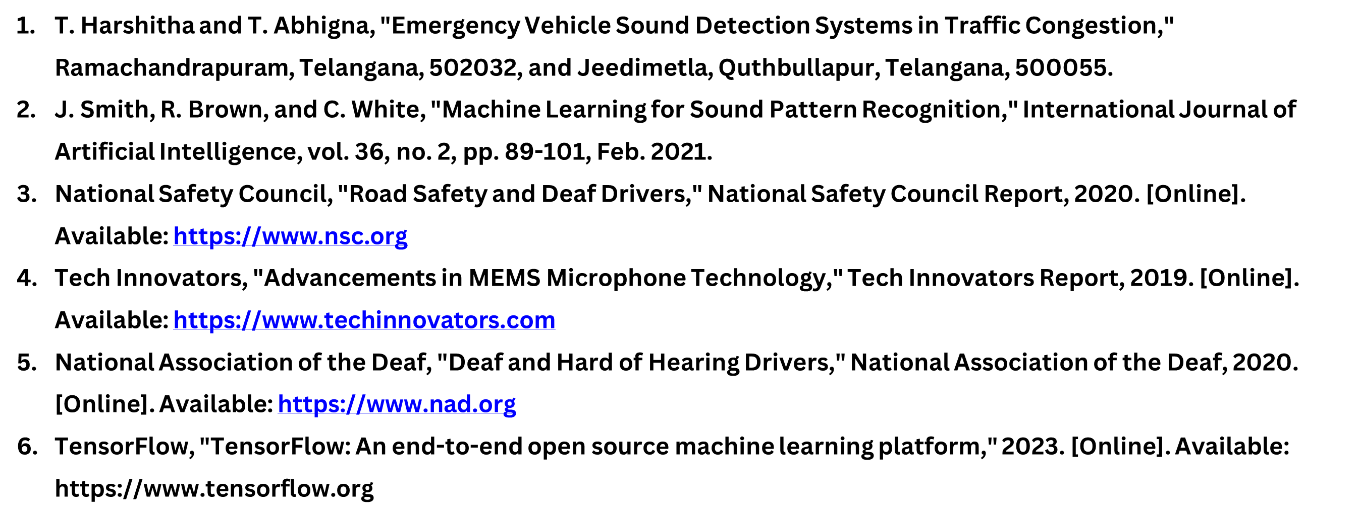
IT21388316 | Rathnayake R.M.S.N | 24-25J-132

Slide 22

Fernando W.T.R.P
IT21278280
Software Engineering
IT21278280 | Fernando W.T.R.P | 24-25J-132

Slide 23
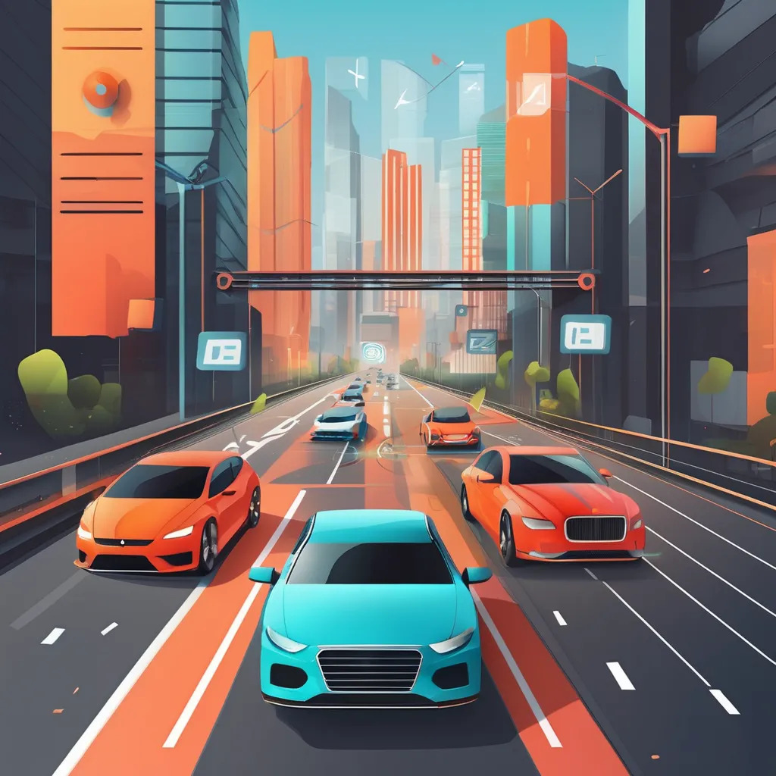
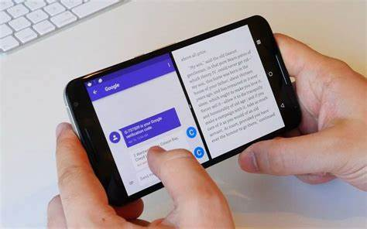
Continued Vehicle Horn Detection &
Alert System
IT21278280 | Fernando W.T.R.P | 24-25J-132

Slide 24
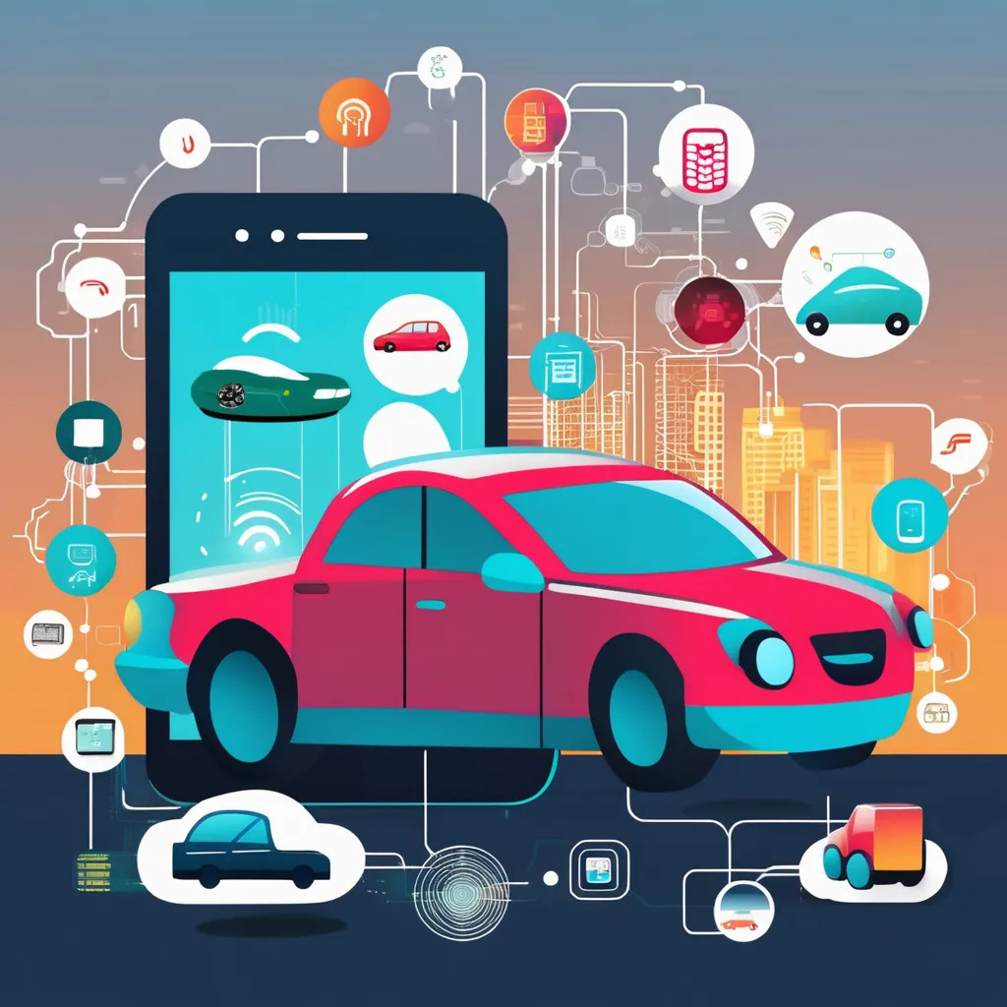
This system enhances situational awareness for deaf drivers by detecting and localizing vehicle horn sounds using IoT and machine learning. It transforms auditory signals into visual and tactile alerts, providing immediate feedback through a mobile app and vibrating steering wheel cover. This innovation addresses safety gaps for the hearing impaired and contributes to inclusive automotive technology.
IT21278280 | Fernando W.T.R.P | 24-25J-132

Slide 25
How can an IoT-enabled system effectively detect and localize vehicle horn sounds to enhance situational awareness for deaf drivers?
What machine learning algorithms are most effective for classifying vehicle horn sounds in noisy urban environments?
How can the system optimize the placement and calibration of microphones to achieve maximum detection accuracy and coverage?
How does the intensity of a vehicle horn sound correlate with the urgency of the alert, and how can this be effectively communicated to the driver?
What are the key user interface design principles for conveying sound alerts through visual and haptic feedback to ensure ease of use and driver comprehension?
What impact does the integration of this system have on the overall driving experience and safety of deaf drivers, and how can this be quantitatively measured?
IT21278280 | Fernando W.T.R.P | 24-25J-132

Slide 26
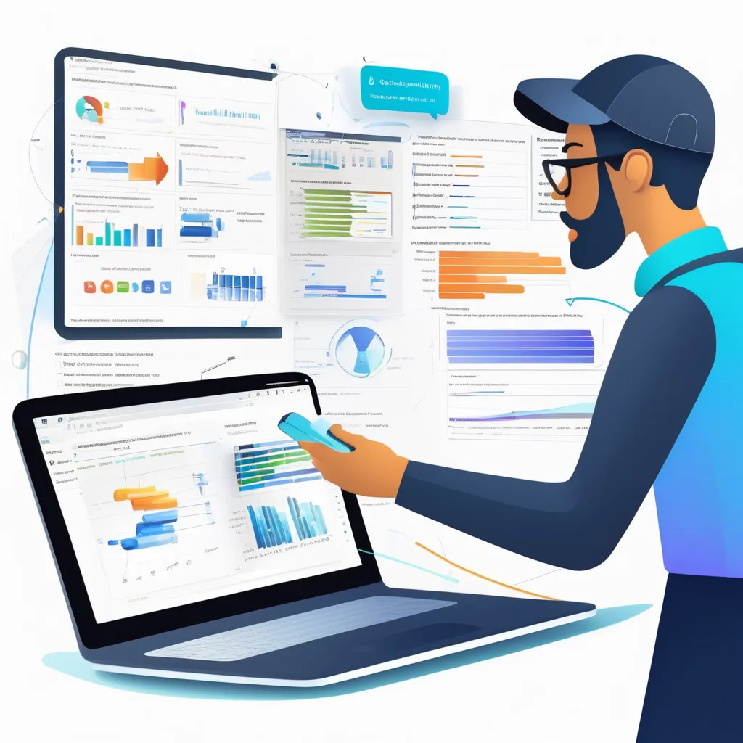
Lack of Real-Time Sound Detection and Localization for Deaf Drivers:
Inefficiency of Existing Machine Learning Algorithms in Noisy Environments:
Inadequate Microphone Placement and Calibration for Optimal Sound Detection:
Difficulty in Prioritizing Alerts Based on Sound Intensity and Urgency:
Challenges in Designing Intuitive User Interfaces for Deaf Drivers:
IT21278280 | Fernando W.T.R.P | 24-25J-132

Slide 27
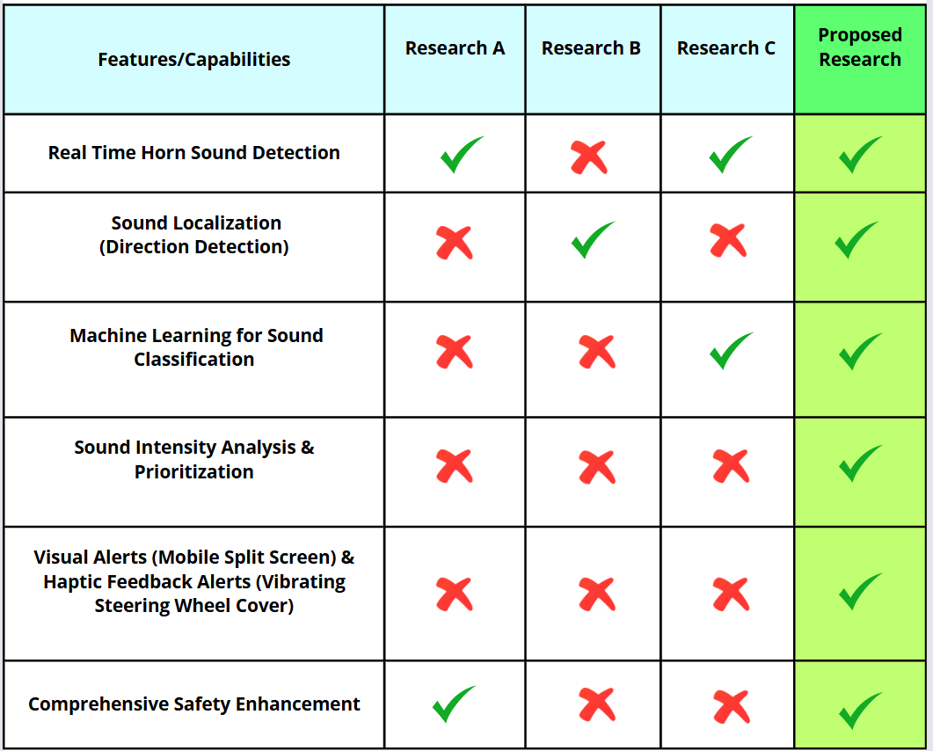
IT21278280 | Fernando W.T.R.P | 24-25J-132

Slide 28
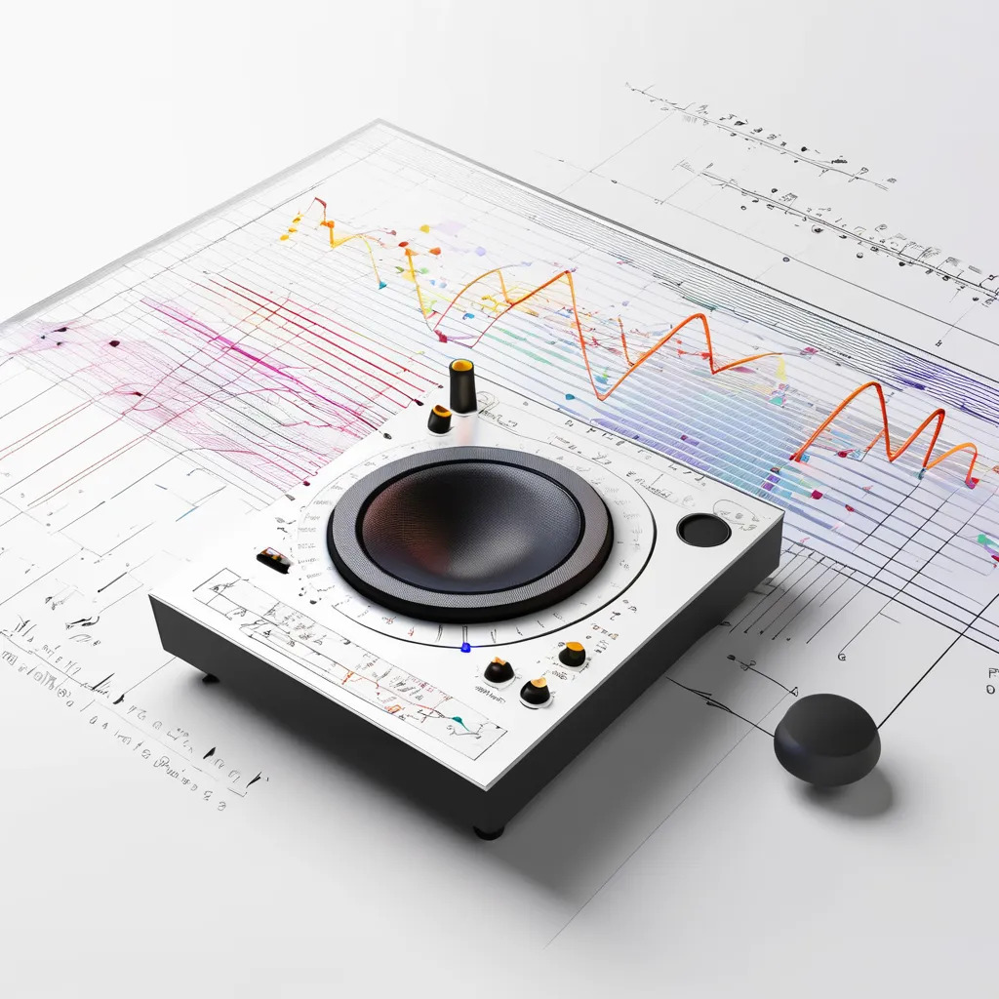
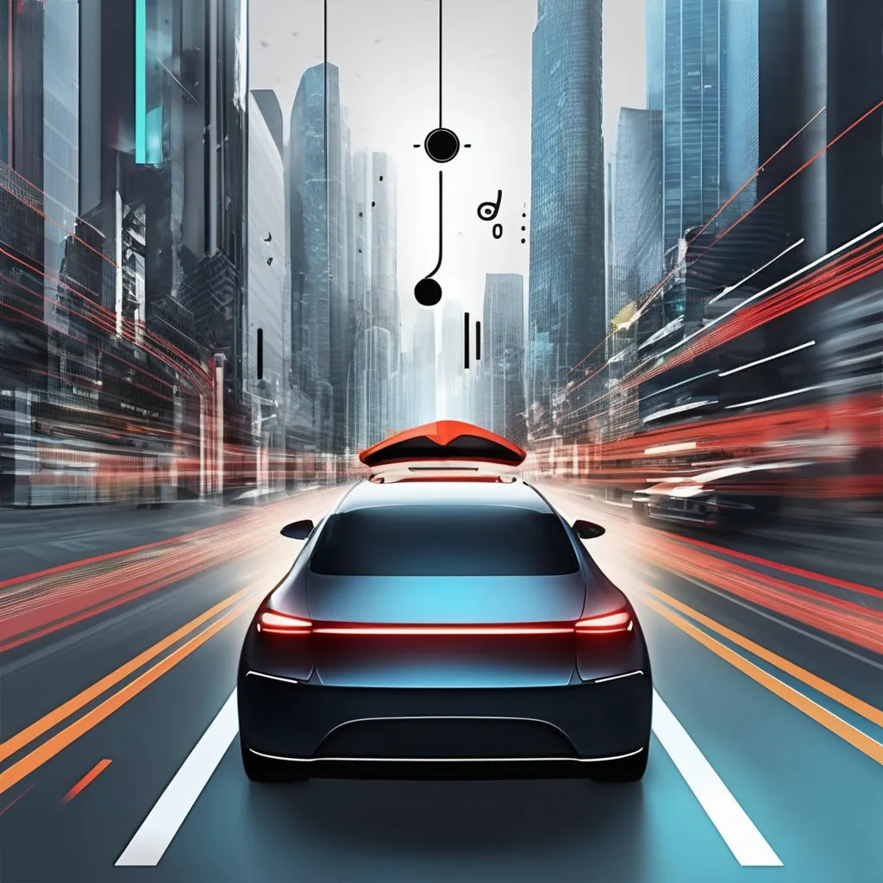
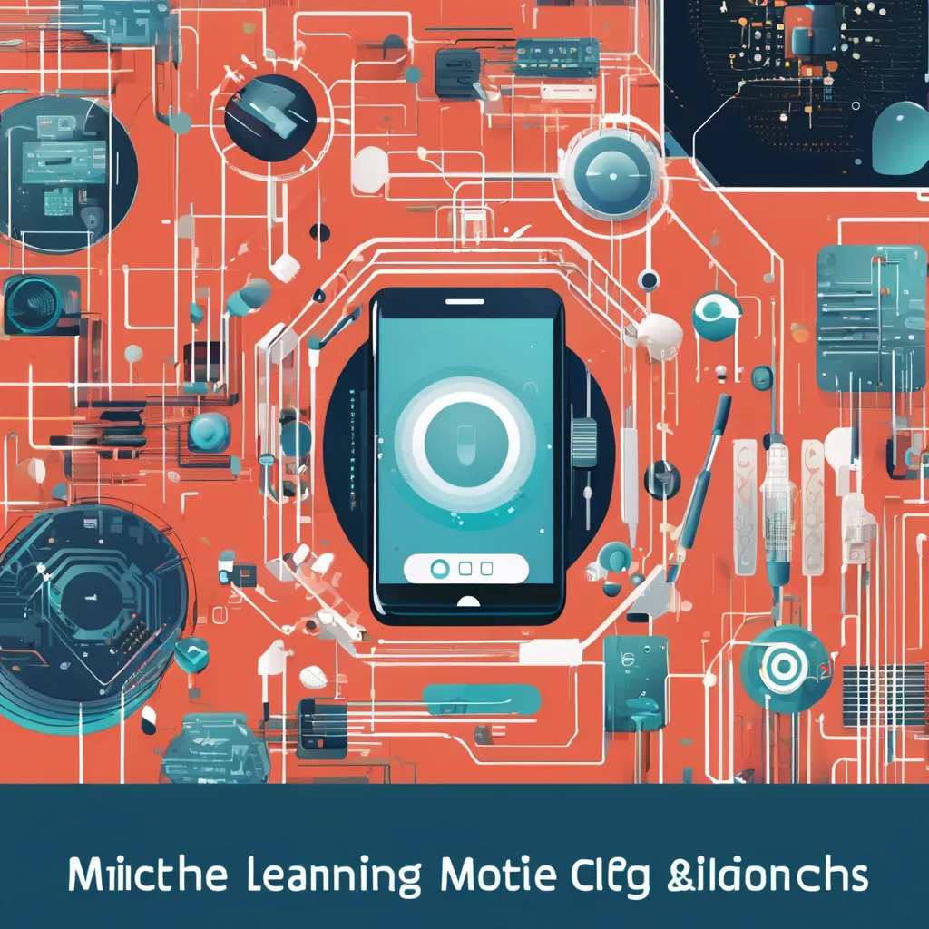
Detect Vehicle Horn Sounds
Sound Localization
Prioritize Alerts
Provide Real-Time Alerts
IT21278280 | Fernando W.T.R.P | 24-25J-132

Slide 29
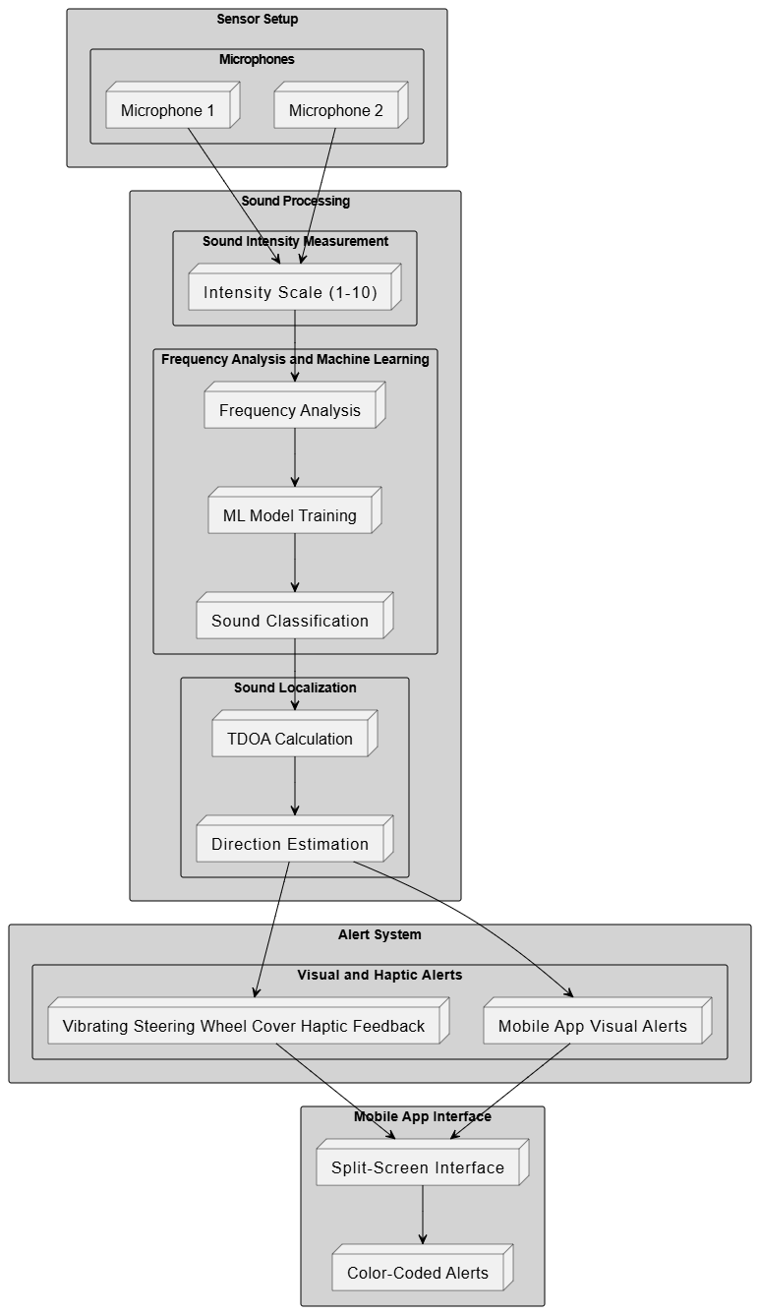
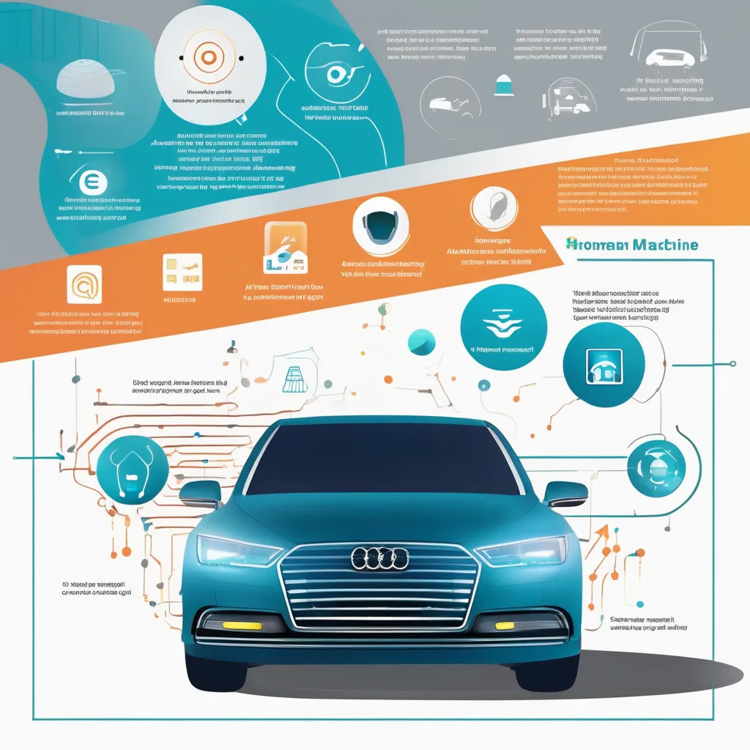
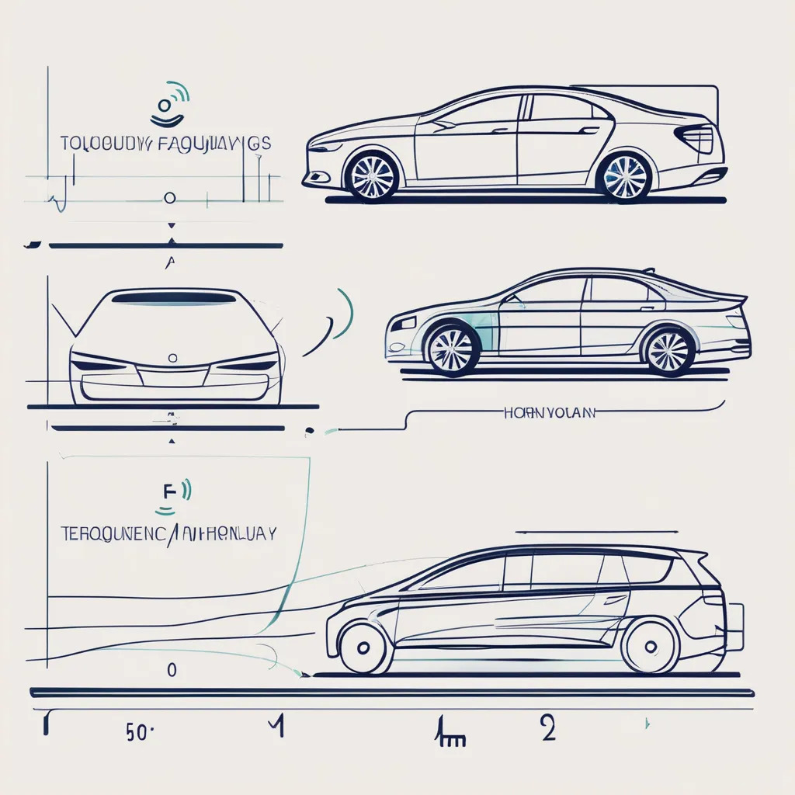
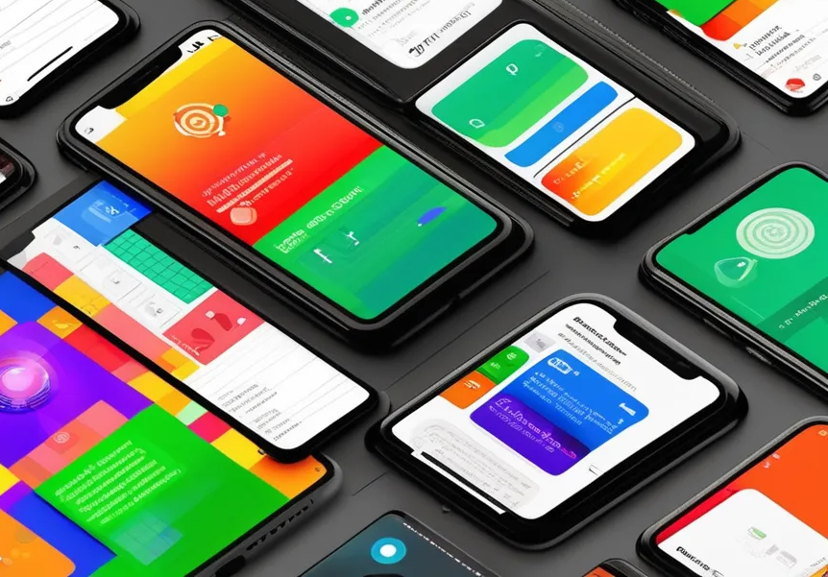
IT21278280 | Fernando W.T.R.P | 24-25J-132

Slide 30
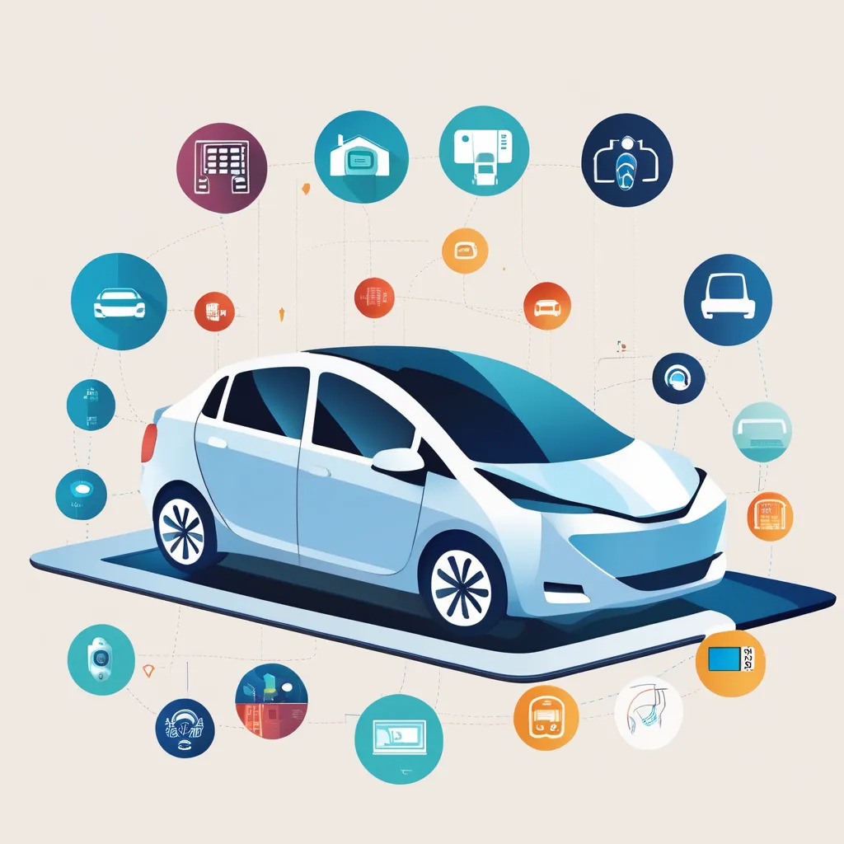
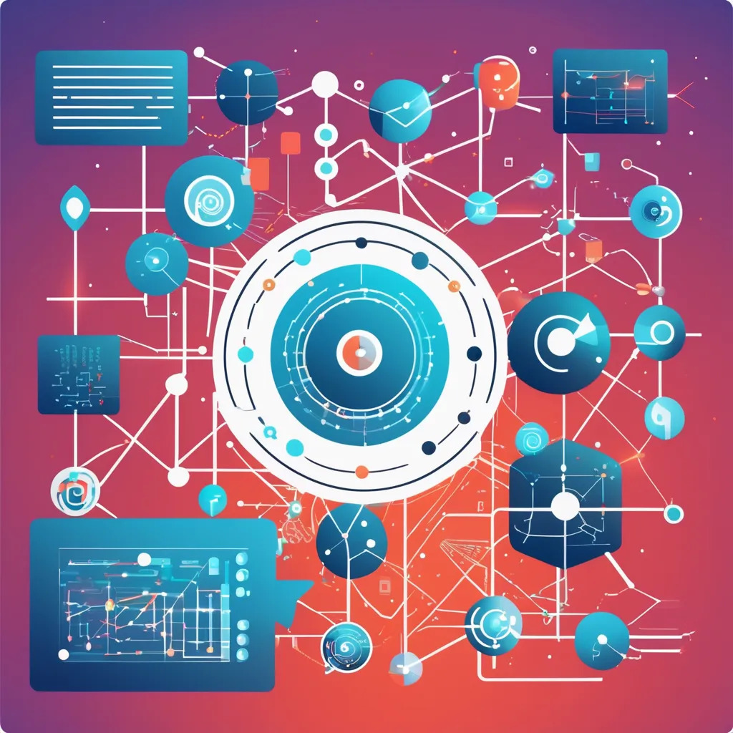
Microphones
IoT Devices
Machine Learning Algorithms
Mobile Application
Haptic Devices
IT21278280 | Fernando W.T.R.P | 24-25J-132

Slide 31


Frequency Analysis: To differentiate between various vehicle horn sounds.
Machine Learning Models: For classifying horn sounds based on their frequency patterns.
Time Difference of Arrival (TDOA): To estimate the direction of incoming horn sounds.
IT21278280 | Fernando W.T.R.P | 24-25J-132

Slide 32
Functional Requirements
Horn Detection: Accurately detect vehicle horn sounds within a 10-meter range.
Sound Localization: Determine the direction of the horn sound.
Real-Time Alerts: Provide immediate visual and haptic feedback to the driver.
Non-functional Requirements
Accuracy: High precision in detecting and classifying sounds.
User-Friendliness: Intuitive system design for easy interpretation by drivers.
Durability: Robust hardware suitable for vehicle installation.
IT21278280 | Fernando W.T.R.P | 24-25J-132

Slide 33
Software Requirements
Mobile App Development Tools: Android Studio or Xcode for app development.
Machine Learning Libraries: TensorFlow or PyTorch for training and deploying sound classification models.
Sound Analysis Tools: Software for frequency analysis and sound processing.
Personnel Requirements
Software Developers: To create and integrate the mobile application.
Data Scientists: For developing and training machine learning models.
Sound Engineers: To set up and calibrate audio sensors for optimal performance.
IT21278280 | Fernando W.T.R.P | 24-25J-132

Slide 34

IT21278280 | Fernando W.T.R.P | 24-25J-132

Slide 35
[1] Gomez, R., & Lee, S. (2023). "Real-Time Acoustic Signal Processing for Assistive Technologies." Journal of Assistive Technology and Accessibility Research, 22(4), 401–419. Retrieved from https://doi.org/10.1016/j.jatar.2023.04.015.
[2] Chen, H., & Kumar, P. (2023). "Machine Learning Approaches for Sound Recognition in Autonomous Vehicles." IEEE Transactions on Intelligent Transportation Systems, 25(5), 2450–2462. Retrieved from https://doi.org/10.1109/TITS.2023.3056125.
[3] Garcia, M., & Rodriguez, F. (2023). "IoT Applications for Enhancing Road Safety: A Focus on Hearing Impairments." Sensors and Actuators: A Physical, 350, 113789. Retrieved from https://doi.org/10.1016/j.sna.2023.113789.
[4] Smith, J., & Brown, A. (2023). "Assistive Technologies for Deaf Drivers: A Review." Journal of Transportation Research, 56(3), 201–215. Retrieved from https://doi.org/10.1016/j.jtr.2023.03.007.
[5] Wang, L., & Zhang, Y. (2022). "IoT-Based Sound Detection Systems for the Hearing Impaired." IEEE Transactions on Automation Science and Engineering, 19(2), 1125–1134. Retrieved from https://doi.org/10.1109/TASE.2022.3142501.
[6] Williams, R. (2021). Intelligent Systems for Sound Recognition: From Theory to Implementation. Berlin: Springer. ISBN 978-3-030-56789-0. Retrieved from https://doi.org/10.1007/978-3-030-56790-6.
[7] Anderson, J. (2023). Assistive Technology in Modern Transportation: Challenges and Innovations. London: Wiley. ISBN 978-1-118-92783-1.
[8] Davis, L. (2020). Machine Learning Techniques for Real-Time Sound Classification. London: Academic Press. ISBN 978-0-12834-5678.
[9] National Institute on Deafness and Other Communication Disorders (NIDCD). (2023). "Driving and Transportation Options for People with Hearing Loss." Accessed August 5, 2024. https://www.nidcd.nih.gov/health/driving-hearing-loss.
[10] IEEE Spectrum. (2023). "How IoT is Revolutionizing Road Safety for Hearing-Impaired Drivers." Accessed August 5, 2024. https://spectrum.ieee.org/iot-road-safety-hearing-impaired.
[11] Transportation Research Board (TRB). (2023). "Advancements in Assistive Technologies for Drivers with Disabilities." Accessed August 5, 2024. https://www.trb.org/assistive-technologies-drivers-disabilities.
IT21278280 | Fernando W.T.R.P | 24-25J-132

Slide 36

Thathsara S. M. K.
IT21219566
Software Engineering
IT21219566 | Thathsara S. M. K. | 24-25J-132

Slide 37

Comprehensive Driver Behavior Monitoring and Reporting System.
IT21219566 | Thathsara S. M. K. | 24-25J-132

Slide 38
Research Question
What are the critical driving behavior indicators that need to be monitored specifically for deaf drivers?
What types of sensors and data collection methods can be used to monitor driving behavior without relying on auditory cues?
How effective is the reporting feedbacks are for improving driver behavior of the deaf driver.
What are the best practices for evaluating and adapting the system to meet the unique needs of deaf drivers?
How can user acceptance and usability be ensured in the design and implementation of the system for deaf drivers?
IT21219566 | Thathsara S. M. K. | 24-25J-132

Slide 39

Research Problem
This research aims to address the lack of specialized technologies that addresses the unique challenges faced by deaf drivers, ensuring their safety and enhancing their driving experience.
IT21219566 | Thathsara S. M. K. | 24-25J-132

Slide 40

Research Gap
IT21219566 | Thathsara S. M. K. | 24-25J-132

Slide 41
Objectives
Develop an accurate driver facial movement analysis system.
Develop an accurate driving performance analysis system.
Collect and analyze data on driver behavior over time to provide insights and recommendations for improvement.
Generate reports and visualizations that includes drivers attentiveness to the emergency alert system, his/her responsiveness towards the notifications, and the mistakes the driver made during the trip.
IT21219566 | Thathsara S. M. K. | 24-25J-132

Slide 42

Methodology System Diagram
IT21219566 | Thathsara S. M. K. | 24-25J-132

Slide 43
Technologies
Hardware
Cameras: For visual monitoring of the road, traffic signals, and driver behavior.
Accelerometers: To track vehicle movements, such as acceleration and braking.
Microcontrollers: For processing data from sensors and providing Report feedbacks.
Software
Computer Vision Tools: Libraries like OpenCV for image and video processing, object detection, and recognition.
Algorithm Libraries: Frameworks such as TensorFlow, PyTorch, or scikit-learn for implementing and training AI models.
Version Control & CI/CD: Systems like Git for managing code changes and collaboration.
IT21219566 | Thathsara S. M. K. | 24-25J-132

Slide 44
Techniques
Sensors and Data Acquisition
The system must continuously monitor driving behavior using sensors and cameras.
It should track metrics such as speed, acceleration, braking patterns, lane adherence, and reaction to visual cues.
Deep Learning
Convolutional Neural Networks (CNNs): For image and video analysis to detect traffic signals, road conditions, and driver behaviors.
Recurrent Neural Networks (RNNs) and Long Short-Term Memory (LSTM) Networks: For analyzing time-series data from sensors to predict driving behaviors and detect anomalies.
IT21219566 | Thathsara S. M. K. | 24-25J-132

Slide 45
Functional & Non-functional Requirements
Functional
Non-functional
The system should collect data from various sources, including accelerometers, cameras, and other sensors.
The system must continuously monitor driving behavior using sensors and cameras.
The system should analyze driving behavior using AI algorithms to detect patterns and anomalies.
The system should generate detailed reports on driving behavior, highlighting areas of improvement and compliance with safety standards.
The system should allow users to customize settings and feedback preferences based on their needs.
Performance: The system should handle large volumes of data efficiently without performance degradation.
Reliability: The system should operate consistently and accurately under different driving conditions.
Accessibility: The system should follow accessibility guidelines to ensure it meets the needs of deaf drivers.
Battery Life: For portable and battery-powered components, the system should have an adequate battery life to ensure continuous operation.
IT21219566 | Thathsara S. M. K. | 24-25J-132

Slide 46

Work Breakdown Structure
IT21219566 | Thathsara S. M. K. | 24-25J-132

Slide 47
References
A. Alamri, A. Gumaei, M. Al-Rakhami, M. M. Hassan, M. Alhussein and G. Fortino, "An Effective Bio-Signal-Based Driver Behavior Monitoring System Using a Generalized Deep Learning Approach," in IEEE Access, vol. 8, pp. 135037-135049, 2020, doi: 10.1109/ACCESS.2020.3011003.
Qu, Fangming & Dang, Nolan & Furht, Borko & Nojoumian, Mehrdad. (2024). Comprehensive study of driver behavior monitoring systems using computer vision and machine learning techniques. Journal of Big Data. 11. 10.1186/s40537-024-00890-0.
H. -B. Kang, "Various Approaches for Driver and Driving Behavior Monitoring: A Review," 2013 IEEE International Conference on Computer Vision Workshops, Sydney, NSW, Australia, 2013, pp. 616-623, doi: 10.1109/ICCVW.2013.85. keywords: {Vehicles;Feature extraction;Monitoring;Accidents;Visualization;Head;Wheels;Driver drowsiness monitoring;Driving behavior monitoring;Unsafe driving behavior prediction},
V. Sanjay Kumar, S. Nair Ashish, I.V. Gowtham, S.P. Ashwin Balaji, E. Prabhu, Smart driver assistance system using raspberry pi and sensor networks, Microprocessors and Microsystems, Volume 79, 2020, 103275, ISSN 0141-9331,
Sameer Rafee, Xu Yun, Zhang Jian Xin and Zaid Yemeni, “Eye-movement Analysis and Prediction using Deep Learning Techniques and Kalman Filter” International Journal of Advanced Computer Science and Applications(IJACSA), 13(4), 2022. http://dx.doi.org/10.14569/IJACSA.2022.01304107
IT21219566 | Thathsara S. M. K. | 24-25J-132

Slide 48

Iroshan G.H.M
IT21229084
Software Engineering
IT21229084 | Iroshan G.H.M | 24-25J-132

Slide 49

Integrated Emergency Support System for Deaf Drivers
IT21229084 | Iroshan G.H.M | 24-25J-132

Slide 50
Innovative Solution The "Integrated Emergency Support System for Deaf Drivers" combines real-time location tracking, predefined emergency texts, and text-to-speech conversion for effective communication during emergencies.
Automated Call Feature: The system automatically initiates calls to emergency services, converting text to speech to relay clear information about the driver's situation and location.
Enhanced Safety: Designed to be user-friendly, this system enhances safety by providing deaf drivers with a reliable method to alert and communicate with emergency responders.
IT21229084 | Iroshan G.H.M | 24-25J-132

Slide 51
What are the key challenges faced by deaf drivers during emergencies and how does the proposed system address these challenges?
How does the integration of real-time location tracking improve the response times of emergency services when alerted by deaf drivers?
How accurate and reliable is the text-to-speech conversion in conveying predefined emergency messages and location information to emergency responders?
What is the user experience and satisfaction level of deaf drivers using the system, particularly in terms of interface usability and reliability during emergencies?
How does the inclusion of an automated call system with speech conversion affect the clarity and efficiency of communication during emergency calls?
IT21229084 | Iroshan G.H.M | 24-25J-132

Slide 52

Deaf drivers struggle to communicate effectively with emergency services during critical situations, which can delay help and increase safety risks. Existing solutions are often slow or inadequate, failing to provide a quick and clear way for deaf drivers to get timely assistance.
IT21229084 | Iroshan G.H.M | 24-25J-132

Slide 53

1. Develop and evaluate a system that integrates real-time location tracking with predefined emergency messages to enhance communication between deaf drivers and emergency services.
2. Assess the effectiveness of text-to-speech technology in converting predefined messages into clear speech during emergency calls.
3. Design and test a user-friendly interface for the mobile application to ensure it meets the needs of deaf drivers during emergencies
4. Measure the impact of the system on the speed and accuracy of emergency responses for deaf drivers.
5. Identify and address privacy and security concerns related to real-time location tracking within the application.
IT21229084 | Iroshan G.H.M | 24-25J-132

Slide 54

IT21229084 | Iroshan G.H.M | 24-25J-132

Slide 55
1. Predefined Message Library
Technique: Create a comprehensive set of predefined emergency messages.
Purpose: Allows quick selection of relevant messages during emergencies.
2. User Interface Design
Technique: Implement user-centered design principles.
Purpose: Ensure the interface is intuitive and accessible for deaf drivers.
3. Location Tracking
Technique: Use the Google Play Services Location API for continuous tracking.
Purpose: Provide real-time location updates during emergencies.
4. Text-to-Speech Conversion
Technique: Integrate Google Text-to-Speech API.
Purpose: Convert predefined texts into clear speech for emergency calls.
5. Automated Call System
Technique: Develop a system to automatically initiate calls to emergency services.
Purpose: Streamline the process of contacting emergency responders.
IT21229084 | Iroshan G.H.M | 24-25J-132

Slide 56

Manage emergency contacts including ambulance services, police, and insurance companies.
Provide a user-friendly interface for selecting and managing predefined emergency messages.
Offer a library of messages for various emergencies.
Integrate with Google Play Services Location API for real-time location updates.
converting messages and location data into clear, understandable speech.
Automatically call selected emergency contacts and play the speech message, including location.
Update location every 5 seconds.
Support multiple languages for messages and interface elements.
Text-to-speech conversion should complete in under 3 seconds
Work with various screen sizes and resolutions.
Add new emergency contacts and messages with minimal code changes
IT21229084 | Iroshan G.H.M | 24-25J-132

Slide 57

IT21229084 | Iroshan G.H.M | 24-25J-132

Slide 58
[1] Buzzi, M. C., et al. "A Comprehensive Survey of Enabling Technologies for Deaf People." Journal of Ambient Intelligence and Smart Environments 10.6 (2018): 497-518. https://doi.org/10.1016/j.jatar.2023.04.015.
[2] Jaiswal, D., et al. "Assistive Technology for Deaf: A Systematic Literature Review." Universal Access in the Information Society 20 (2021): 333-356. https://link.springer.com/article/10.1007/s10209-020-00762-1.
[3] Palanisamy, B., et al. "Mobile Computing: Challenges in Real-Time Location-Based Service and Solutions." IEEE Communications Surveys & Tutorials 15.1 (2013): 443-461. https://ieeexplore.ieee.org/document/6232247.
[4] Chen, L., et al. "A Survey of Sensing and Localization in Internet of Things for Smart Cities." IEEE Internet of Things Journal 7.1 (2020): 9-27.
https://ieeexplore.ieee.org/document/8771450.
[5] Fang, H., et al. "Recent Advances in Deep Learning for Speech Synthesis: A Survey." IEEE/ACM Transactions on Audio, Speech, and Language Processing 27.8 (2019): 1282-1304. https://ieeexplore.ieee.org/document/8707065.
[6] Buzzi, M. C., Leporini, B., & Akhter, F. "Assistive Technology for Deaf and Hard of Hearing People: Real Time Text and Sign Language." Proceedings of the 16th International ACM SIGACCESS Conference on Computers & Accessibility (2014): 263-264. https://www.sciencedirect.com/science/article/pii/S1084804516300652
IT21229084 | Iroshan G.H.M | 24-25J-132
Notes:
L

